Slide 1
NC Department of Health and Human Services NC Division of Social Services
Triple P in NC Child Welfare Services
Deborah Day
Community Based Programs Administrator
May 12, 2021

Slide 2
NCDSS Child Welfare Funding
$1.975M recurring state allocation
In 2016, Expansion from 37 to 100 counties through 9 Local Implementing Agencies
NCDSS Funds Triple P Infrastructure:
Division of Public Health
Local Implementing Agencies and Training
UNC Frank Porter Graham Impact Center
Child Welfare Implementation Specialist
Prevent Child Abuse North Carolina
Technical Assistance and Implementation Support
Notes:
These funds allowed DSS to partner with DPH to enhance the existing system to increase of the availability and expansion of Triple P. County child welfare agencies were already part of the Triple P System and many workers had been trained.
DSS invested its Triple P appropriation in the statewide population level implementation, which research indicates has higher outcomes than individual site implementation. Decision to invest money with DPH to build system, of which county DSS was a part.
We know that training is not sufficient for model fidelity and high-quality service delivery. Research indicates that investments are stronger when accompanied by implementation support. NC’s Triple P system includes 10 Local Implementing Agencies, Triple P America, The Impact Center at Frank Porter Graham at UNC-Chapel Hill, and Prevent Child Abuse North Carolina.

Slide 3
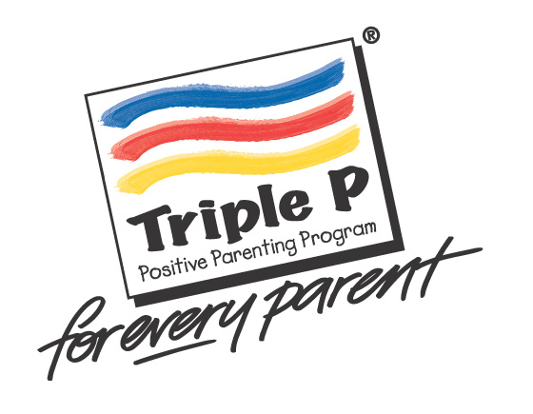
Why Triple P in North Carolina?
Population-based approach to parenting
Destigmatized process for families seeking help and information
Training of existing workforce to deliver Triple P by incorporating it into their current practice
Positive approach to parenting support
Evidence-based and a good investment
Prevents Child Maltreatment, Reduces Foster Care Placements, and Supports Families
Ultimate Goal = “Triple P Spoken Here”
Notes:
Triple P provides a cost-effective prevention of child maltreatment, reduces foster care placements, and provides supportive intervention for those experiencing child and parental difficulties (Prinz et al., 2009).
Ultimate Goal: “Triple P Spoken Here”

Slide 4
Victims of Crime Act Triple P Grant
NC Governors Crime Commission Grant
July 1, 2021 – September 30, 2022
$1.57 million over two-year grant period
7 Regional Triple P Practitioners will provide Level 4, Standard Triple P
400 Foster & Kinship Families with children age birth – 12 years old
Level 4, Triple P Standard or Group Training for 180 foster Care, licensing, and child placing agency staff.
Notes:
During SFY 2019, 11,934 unique children between the ages of 0-12 were provided foster care services in NC. These children were found to be victims of child abuse and/or neglect after completion of a Child Protective Services assessment of maltreatment by a parent or caretaker.
To date, approximately 200 child welfare workers have been trained in Triple P to support family engagement and enhance child safety.
Start training in August 2021.

Slide 5
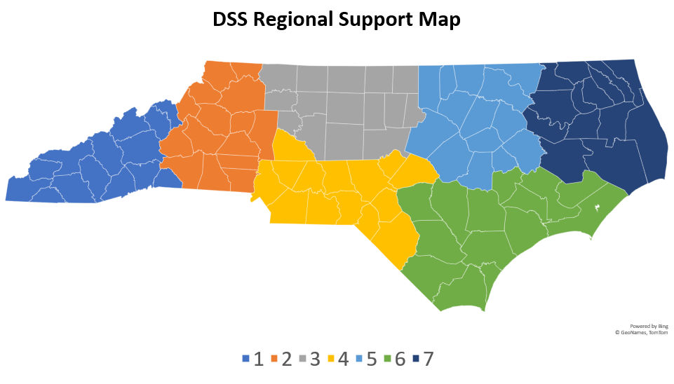

Slide 6

VOCA Triple P Anticipated Outcomes
65% of participating children will show improvements in social, emotional, and behavioral adjustment.
The rate of out-of-home placement moves per 1,000 days of foster care will not exceed 4.1 per day per 1,000 days in care for participating children and families.
Notes:
Foster/kinship parents who are empowered and less stressed in their parenting are able to derive more satisfaction from their family relationships, which reduces the likelihood of a child moving from home to home (Prinz & Sanders, 2010).

Slide 7
VOCA – CW Implementation Connection
VOCA Practitioners will work with county foster care staff to identify and engage kinship and foster parents.
FPG CW Implementation Specialist will support this project by:
Connecting child welfare to Local Implementing Agencies (LIAs).
Supporting CW capacity and sustainability after VOCA
Consulting on project protocol, data, and outcomes
Notes:
Practitioners will work with currentfoster care staff within county departments of social services to identify and engage kinship/foster parents in need of support. Contractedpositions including an Implementation Specialist with the UNC Frank Porter Graham Child Development Institute as well as a Triple PSupervisor with the Division of Public Health are positions supporting this project. They are assisting NCDSS with connecting child welfare to10/20/2020 GEMS https://gems.ncdps.gov/Application/Submit/50588566-e520-e911-bb21-005056af0323 3/14
existing Triple P Lead Implementing Agencies around the state. They support capacity building needed to develop a sustainab

Slide 8


Family First Prevention Services Act
Triple P, Level 4 is an evidence-based program listed on the Title IV-E Prevention Clearinghouse.
NC DSS FFPSA Triple P Implementation – 2022
VOCA Grant will build Triple P Capacity in county child welfare agencies in preparation for Family First implementation.
Notes:
Because Triple P is rated as an evidence-based program, the federal government requires a rigorous evaluation design and continuous quality improvement process.

Slide 9
Alignment of Triple P with FFPSA Prevention Plan
Title IV-E Clearinghouse Rating = Promising
Serves Families With Children, Age Birth to 18 Years
Existing Infrastructure in North Carolina
Existing Implementation Support in North Carolina
Less Intense than Other EBPs Selected
Promotes Positive Parenting Behaviors and Improves Family Functioning
Notes:
Practitioners will work with currentfoster care staff within county departments of social services to identify and engage kinship/foster parents in need of support. Contractedpositions including an Implementation Specialist with the UNC Frank Porter Graham Child Development Institute as well as a Triple PSupervisor with the Division of Public Health are positions supporting this project. They are assisting NCDSS with connecting child welfare to10/20/2020 GEMS https://gems.ncdps.gov/Application/Submit/50588566-e520-e911-bb21-005056af0323 3/14
existing Triple P Lead Implementing Agencies around the state. They support capacity building needed to develop a sustainab

Slide 10
Triple P Online Codes
Evidence-based, flexible program for families of children, age birth-16 years old.
NC Triple P Online Program is available to NC parents in all 100 counties at no cost to them.
2 Trainings: Toddlers – Tweens and Pre-teens & Teens
8 modules - video clips, worksheets and activities
Telephone and email support available
12 months to complete
Adapted for COVID-19 Pandemic
Access NC Triple P Online codes here.
Notes:
Triple P = Positive Parenting Program
19,500 Online Codes are currently available as of October 1, 2020.
English, Spanish, and Arabic (0-12 years old)
Parents, caregivers, cw workers, school psychologists, guidance counselors, and teachers can easily register and complete the modules themselves. Although users can access additional telephone and email support if needed.
In 2019, NC used ~6,000 online codes. As of October 1, 2020, NC had used 5,300 codes. This increased rate can be explained by fewer in-person services available due to the pandemic.
Triple P Online (for toddlers to tweens) can help you:
• Encourage good behavior
• Manage misbehavior
• Settle tantrums
• Take the stress out of shopping
• Tackle disobedience
• Teach your child new skills
Teen Triple P Online (for preteens and teens) can help you:
• Communicate better
• Build a stronger relationship
• Agree on rules
• Deal calmly with conflict
• Navigate emotional ups and downs
• Equip your teen to handle life’s challenges
Each module takes approximately 30-45 minutes to complete. They are designed to do once per week, but parents have up to 12 months to complete.
There is a 3 minute video on the link above that provides an overview of Triple P Online .

Slide 11

Family Support Programs – Triple P, Level 4
11 out of 43 FS Applications proposed Triple P
4 proposed Standard only
4 proposed Group only
3 proposed both Standard and Group

Slide 12
Prevention Program Consultant
Coordinate NCDSS Triple P Efforts, including VOCA Grant.
Provide support to:
The Partnership for Strategy and Governance
NC Learning Collaborative
NCDSS Steering Committee
UNC Impact Center,
NC Division of Public Health
Prevent Child Abuse NC
Notes:
We are interviewing right now and hope to hire someone starting in July 2021

Slide 13
Triple P Capacity Building Center
Brief highlight NC Triple P as a primary prevention strategy: “Working Across the Prevention Continuum.” The link is: https://capacity.childwelfare.gov/pubPDFs/cbc/prevention-continuum-strengthen-families-cp-20119.pdf
Prevention Panel Presentation – April 15, 2021 – “History of Triple P Collaboration in NC”
Notes:
Phil Redmond – Duke Endowment – provided historical context for the NC Triple P Collaboration.
Kathy Stone – NCDSS – connected Triple P to the NC DSS’s comprehensive prevention planning efforts.
Barbara Young – CWFAC Family Partner – shared her experience receiving and providing Triple P as a Peer Partner for families involved in child welfare in Alamance County.
Deborah Day – provided information on how all of these pieces fit together.

Slide 14
Contact Information
Deborah Day
Community Based Program Administrator
NC DHHS, Division of Social Services
(919) 527-6436
Deborah.day@dhhs.nc.gov

