Slide 1
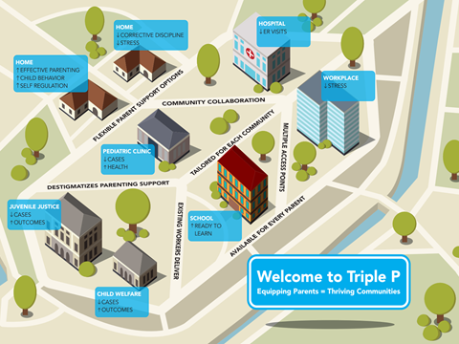
First, what are we trying to do with this capacity-building? Capacity for what?
We are building the capacity to scale up the System of Triple P...
...by building a visible infrastructure
Governance and decision-making structures
Administrative structures
Policies, operating procedures, and protocols
Human resources, recruitment, and staff selection
Training system
Supervisory and coaching system
Service array and service delivery system
Information system and data supports
Evaluation, quality assurance, and continuous quality improvement systems
Communication systems (internal)
Communication systems (external)

Slide 2
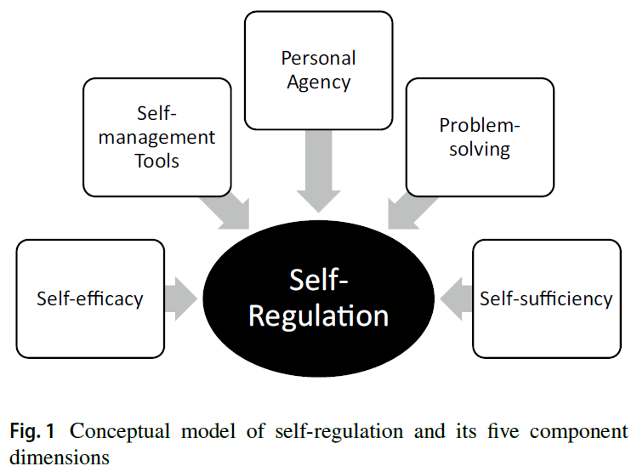
Ultimate Goal: Communities Will Self-Regulate Capacity and Performance
(Sanders & Mazzucchelli, 2013; Roppolo et al., 2019)
Notes:
Sanders, M. R. and T. G. Mazzucchelli (2013). "The promotion of self-regulation through parenting interventions." Clin Child Fam Psychol Rev 16(1): 1-17.
Roppolo, R. H., et al. (2019). "Is the Concept of Self-Regulation Useful for Supporting Effective Implementation in Community Settings?" Clinical Child and Family Psychology Review.

Slide 3
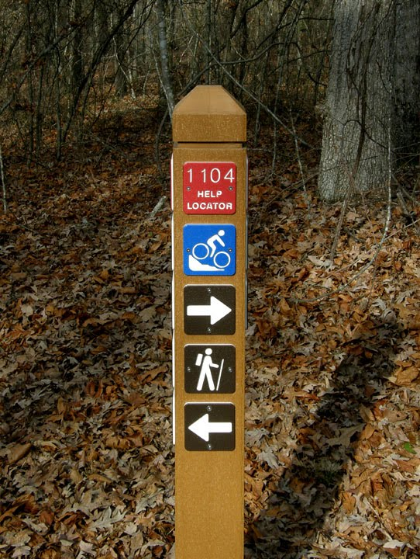
Getting There: Implementation Stages
Initial Implementation
Full Implementation
Exploration
Installation
Assess needs
Create readiness
 Identify usable interventions
Develop team structures
Develop communication plans
Identify organizational changes
Select and train first practitioners
Develop coaching plans
Evaluate data systems
Assess practitioner supports
Provide coaching
Repurpose organization roles
PDSA cycles
Policy-practice feedback cycles
Skillful practices by all staff
Evaluation for outcomes
Implementation drivers
Improvement cycles
Share success
2-4 Years
Notes:
Because we don’t appreciate the amount of time it takes, we keep throwing out effective programs before they have a chance to achieve outcomes.
Bierman, K. L., Coie, J. D., Dodge, K. A., Greenberg, M. T., Lochman, J. E., McMahon, R. J., et al. (2002). The implementation of the Fast Track Program: An example of a large-scale prevention science efficacy trial. Journal of Abnormal Child Psychology, 30, 1-17.
Fixsen, D. L., Blase, K. A., Timbers, G. D., & Wolf, M. M. (2001). In search of program implementation: 792 replications of the Teaching-Family Model. In G. A. Bernfeld, D. P. Farrington & A. W. Leschied (Eds.), Offender rehabilitation in practice: Implementing and evaluating effective programs (pp. 149-166). London: Wiley.
Panzano, P. C., & Roth, D. (2006). The decision to adopt evidence-based and other innovative mental health practices: Risky business? Psychiatric Services, 57, 1153-1161.
Prochaska, J. O., & DiClemente, C. C. (1982). Transtheoretical therapy: Toward a more integrative model of change. Psychotherapy: Theory, Research and Practice, 19, 276-287.
Saldana, L., Chamberlain, P., Wang, W., & Brown, H. C. (2011). Predicting program start-up using the stages of implementation measure. Administration and Policy in Mental Health, 39, 419-425.

Slide 4
Co-Creation
Partner Support
Local Implementation & Scale-up
Optimization of Implementation
Population-level
Outcomes
Capacity
Performance
Service agency leadership & staff
State/local funders & policymakers
Intervention purveyors & Intermediary partners
Families & community members
Intervention developers
Leadership & implementation teams
Workforce development systems
Quality & outcome monitoring systems
Media & networking systems
Leading & supporting implementation
Developing confident & competent practitioners
Gathering, analyzing, & reporting data
System-wide learning & improvement
Mobilizing knowledge & behavior change
Accessibility
System alignment
Feasibility
Appropriateness
Fidelity
Adherence
Quality
Caregiver engagement
Dosage
Acceptability
Reach
Cost
Sustainability
Increases in indicators related to advantageous child & youth experiences, development
Decreases in indicators related to adverse child & youth experiences, development
Sustainment
Notes:
What small changes are going to lead to the most success?
Aldridge, W. A., II, Boothroyd, R. I., Veazey, C. A., Powell, B. J., Murray, D. W., & Prinz, R. J. (2018, May). Ensuring Active Implementation Support for North Carolina Counties Scaling the Triple P System of Interventions. Chapel Hill, NC: The Impact Center at Frank Porter Graham Child Development Institute, University of North Carolina at Chapel Hill.
Chinman M, Acosta J, Ebener P, Malone PS, Slaughter ME. Can implementation support help community-based settings better deliver evidence-based sexual health promotion programs? A randomized trial of Getting To Outcomes®. Implementation Science. 2016;11(1):78.

