Slide 1
NC CHILD WELFARE TRIPLE P LEARNING COLLABORATIVE
Christina DiSalvo, Implementation Specialist
Impact Center at FPG, UNC-CH
June 29, 2022
Notes:
Hi & welcome to our 5th CWTPLC, we are so grateful to those of you who are back again. For those of you that are new, welcome and don’t hesitate to ask questions by taking yourself off of mute or adding something to the chat.
I am joined today by several of my peers in the NC Triple P system, including Deborah Day with NCDSS. We will also be joined by several local CW agencies today to talk to you about their TP journey.

Slide 2
RECORDING OF JUNE 22, 2022 NC CHILD WELFARE TRIPLE P LEARNING COLLABORATIVE
https://uncch.hosted.panopto.com/Panopto/Pages/Viewer.aspx?id=9fb30e2f-9e9c-4c87-9a00-aec3014839ee

Slide 3
Objectives
Triple P Refresher
Reviewing Triple P State Data Requirements
Discuss implementation challenges and successes among peers and broader NC Triple P network.
Notes:
We have spent the last 3 sessions building your awareness of not just TP the program, but why the process of implementation matters. Meaning why it matters to examine and attend to the things that will create the conditions to support successful and sustainable delivery of TP. The building and supporting of resources, the skills, and abilities of agencies and people to deliver TP as intended.
Then, rather than continuing to talk to you about best practices that we know research tells us are effective, we are going to hear from our TP regional LIAs about how these bring these practices to your agencies through a variety of supports.
Finally, we are spending the last hour hearing from you. Having you discuss and roster challenges and leaning on your peers to learn about approaches they have taken in similar situations.

Slide 4
What Are Our Goals?
Increased awareness of Triple P and fit with child welfare needs.
Increased knowledge of practices and structures that support successful program delivery.
Increased use of implementation tools, resources, and support.
Notes:
We always ensure our objectives are aligned with our overarching LC goals, seen here. Basically, learning together through sharing of successes and challenges in implementing TP in local communities, specifically CW agencies. Leaning on one another through a peer network and sharing/utilizing tools and resources along the way.

Slide 5


What We Are Trying to Accomplish
Increased likelihood of Triple P being used as intended.
Increased likelihood families will benefit from the program.

Slide 6
Waterfall Chat
What wishes and aspirations do you have for today?
Notes:
So get your chat boxes open, but don’t hit enter quite yet. 20 seconds to populate responses.
Shannon to relay responses. Hope we will meet your wishes and aspirations through our session today.

Slide 7

Previous Peer-Support Takeaways

Slide 8
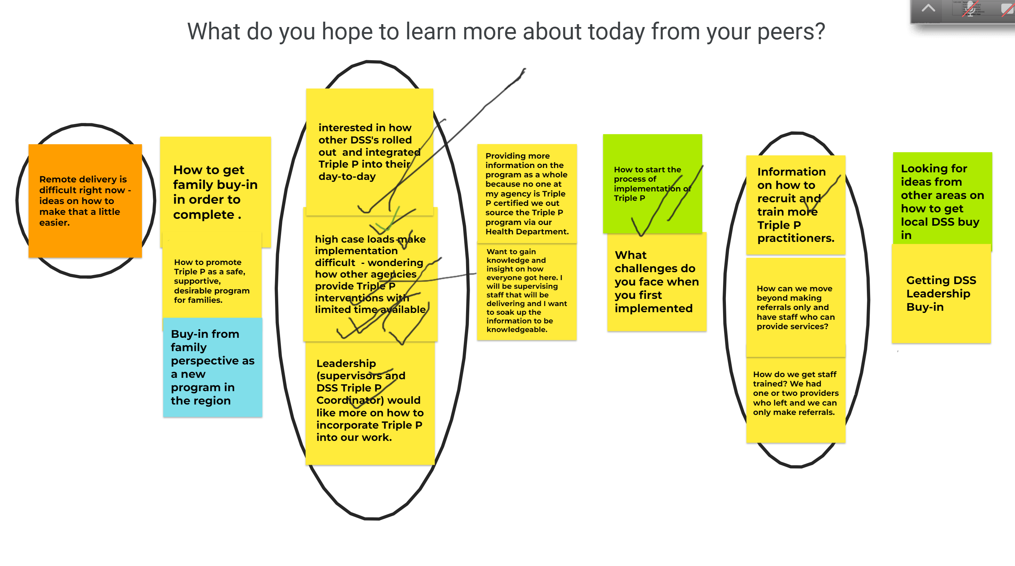
Notes:
Lack of preparedness prior to Triple P training roll-out ▪ Selected training levels not conducive to position responsibilities ▪ Practitioners & Supervisors not adequately prepared ▪ Unclear practitioner expectations post-training ▪ Lack of knowledge & ability to provide support after training on: ▪ How to dovetail Triple P with other CW responsibilities ▪ How to adapt Triple P to CW population, while maintaining fidelity to the model ▪ Multiple changes in executive leadership and ongoing competing priorities
Outcome: Approximately 90% of trained staff did not consistently provide interventions, turn in data or attend peer support groups
Workers feel Triple P is an “add-on” to their role rather than a new way to deliver service.
Getting buy-in from across the entire agency while also ensuring staff feel empowered and knowledgeable.
Supervisors are not trained in Triple P. This situation has created challenges with workers feeling in need of support to implement Triple P into regular practice.
Family engagement in the program.
Personal characteristics of the parent can create challenges in delivery of Triple P, such as level of education, cognitive ability, level of engagement in the program and whether the courts are ordering the parents to participate in Triple P.
Challenges with engagement as parents fear being judged because of our mandate = fear of not being the perfect parent
Challenge to measure how Triple P contributes to outcomes as it is offered as part of our service delivery model.

Slide 9
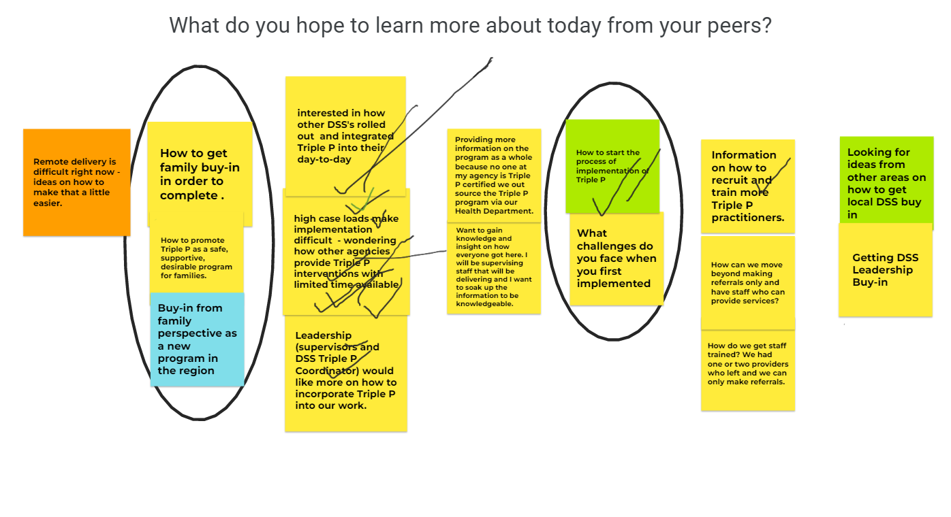

Slide 10
Theme Discussions
Attending ongoing readiness
Importance of recruitment & selection of practitioners
Value of supports & Resources
Notes:
“In a survey of 400 organizations, Deloitte and Touche (1996) found that employees’ resistance to change is the number one reason why organization change initiatives fail. Many times resistance is caused by poorly planned implementation of change initiatives (Winum, Ryterband, & Stephensen, 1997; Conner, 1992). A common mistake made by leaders is to think that because they are now ready to take action, they can impose action initiatives on employees who are not prepared.” Prochaska et al. (2001, p. 253)

Slide 11
Triple P Positive Parenting Program
North Carolina Child Welfare Learning Collaborative
June 2022

Slide 12
Why do we do what we do?
Parents are crucial in the development of children.
All parents need support.
Child maltreatment prevention requires a public health approach.
Every child deserves to grow up in a safe, stable, and nurturing environment.
Families need advocacy in federal and local policy decisions.
No one program is the panacea. It is going to take a system of care to build a happy, healthy, and productive next generation.
Notes:
Because parents are crucial in the development of children (and they want the best for their children)
Because all parents need support
Because child maltreatment prevention requires a public health approach
Prevention through treatment
No one sector can be responsible for prevention of child maltreatment
Because the aim is to do more than just prevent maltreatment, it is to ensure safe, stable, and nurturing environments to all children, so that they can have the best chance of achieving their potential
Because families, parents, and children need advocacy in federal and local policy decisions
And because no one program is the panacea … it is going to take a system of care that provides an array of evidence-based programs to build a next generation that is happy, healthy, and productive.

Slide 13

The Triple P System

Slide 14
What is Triple P?
The Triple P – Positive Parenting Program® is a system of evidence-based education and support for parents and caregivers of children and adolescents.
Population Health Approach
Tailored support for every family
40 + Years and Counting
Supported by extensive research base
Proven Results
Improves parenting skills and confidence
Notes:
The Triple P model was developed by Professor Matt Sanders at the University of Queensland over 35 years ago and continues to be evaluated and tested to this day. What started as an approach for families in need of intensive support has progressed to a public-health model with a population-level approach—designed to support the needs of every parent.

Slide 15
What can Triple P do?
Promote children’s social, emotional, developmental, and behavioral health
1
Reduce the incidence of child maltreatment in the community
2
Enhance the knowledge, skills, and confidence of parents
3
Build upon parent strengths and abilities to be self sufficient and self-reflective
4
Notes:
As one of the most researched parenting programs in the world, the Triple P model has demonstrated in evaluations –both in clinical research and in independent findings from the field—to have a positive affect in these areas. (MORE PRESENTED ON RESEARCH IN FURTHER SLIDES)

Slide 16
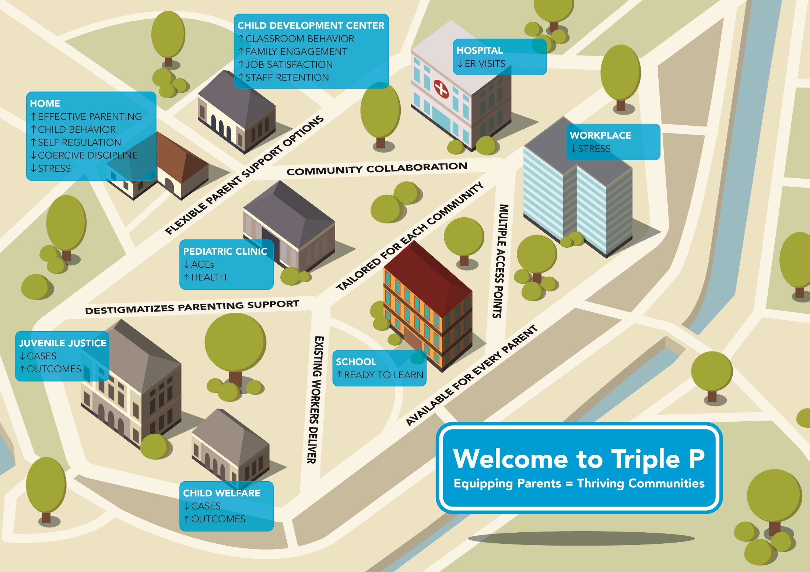
What does a public health approach to parenting support look like?
Notes:
Drawing together the benefits of population-based and public health approaches with the provision of evidence-based parenting supports – aiming to provide support and strengthen all families in a community.
Outcomes from implementing the full Triple P system can positively affect multiple aspects of community living

Slide 17
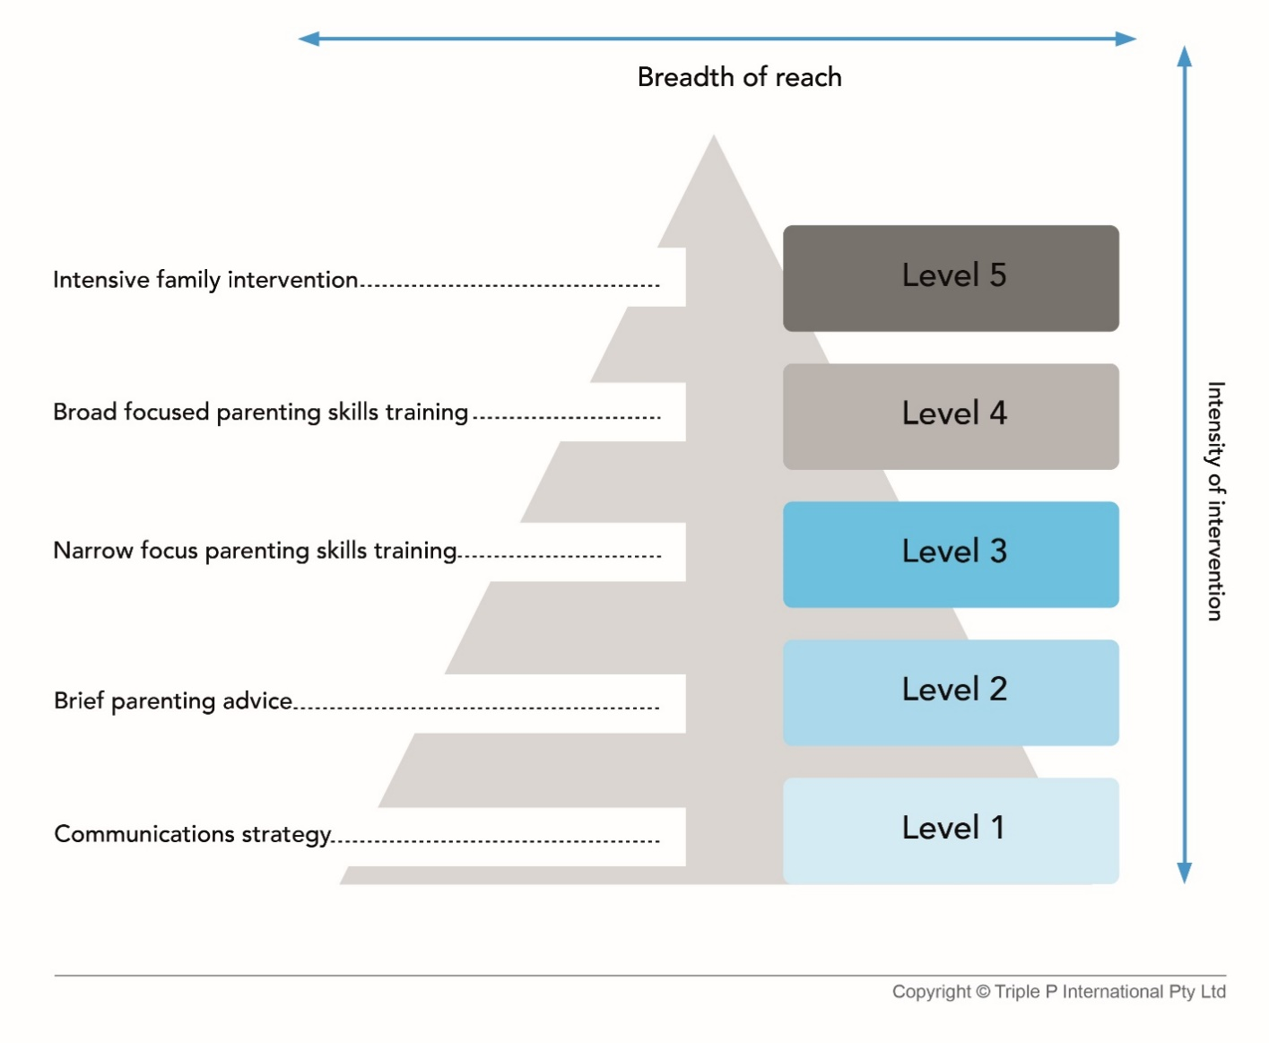
Not a one-size fits all model
Notes:
TRIPLE P INCLUDES 5 LEVELS OF INCREASING INTENSITY OF INTERVENTION. HAVING THIS CREATES A FLEXIBLE CAPACITY TO RESPOND TO THE FACT THAT NO 2 FAMILIES ARE ALIKE (AND FOR THAT MATTER, NEITHER ARE MOST AGENCIES AND STAFF).
LEVEL 1 AND LEVEL 2 TRIPLE P ARE FOR EVERYONE – BY DESIGN. ALL OTHER LEVELS – 3-5 – CAN BE STANDALONE – STUDIED AND PROVEN EFFECTIVE AS SUCH. BUT TO IMPACT A POPULATION, ALL LEVELS 1-5 – WOULD BE USED (AS IN THE CDC FUNDED SC POPULATION TRIAL TO BE COVERED LATER)

Slide 18

Triple P System
Level 5: Pathways, Enhanced
Level 4: Standard, Group, Online, Self-Directed
Level 3: Primary Care, Discussion Groups
Level 2: Brief Primary Care, Seminars
Level 1: Universal Campaign /Media Strategy

Slide 19
Triple P is for Every Parent
For parents of children 0-16 years.
Families with a range of needs, including:
Normal developmental concerns.
Internalizing and externalizing disorders.
Developmental delays.
Separation or divorce.
Overweight/obese children.
Families from many cultures, socio-economic groups, and different family structures.

Slide 20
What outcomes does Triple P achieve for families, parents, and children?
Triple P is one of the world’s most researched programs with over 40 years of research.
The evidence consistently shows:
Increased positive parenting
Reduced coercive parenting
Lower social, emotional and behavior problems
Improved parent-child relations
Decreased parent stress
https://pfsc-evidence.psy.uq.edu.au/

Slide 21
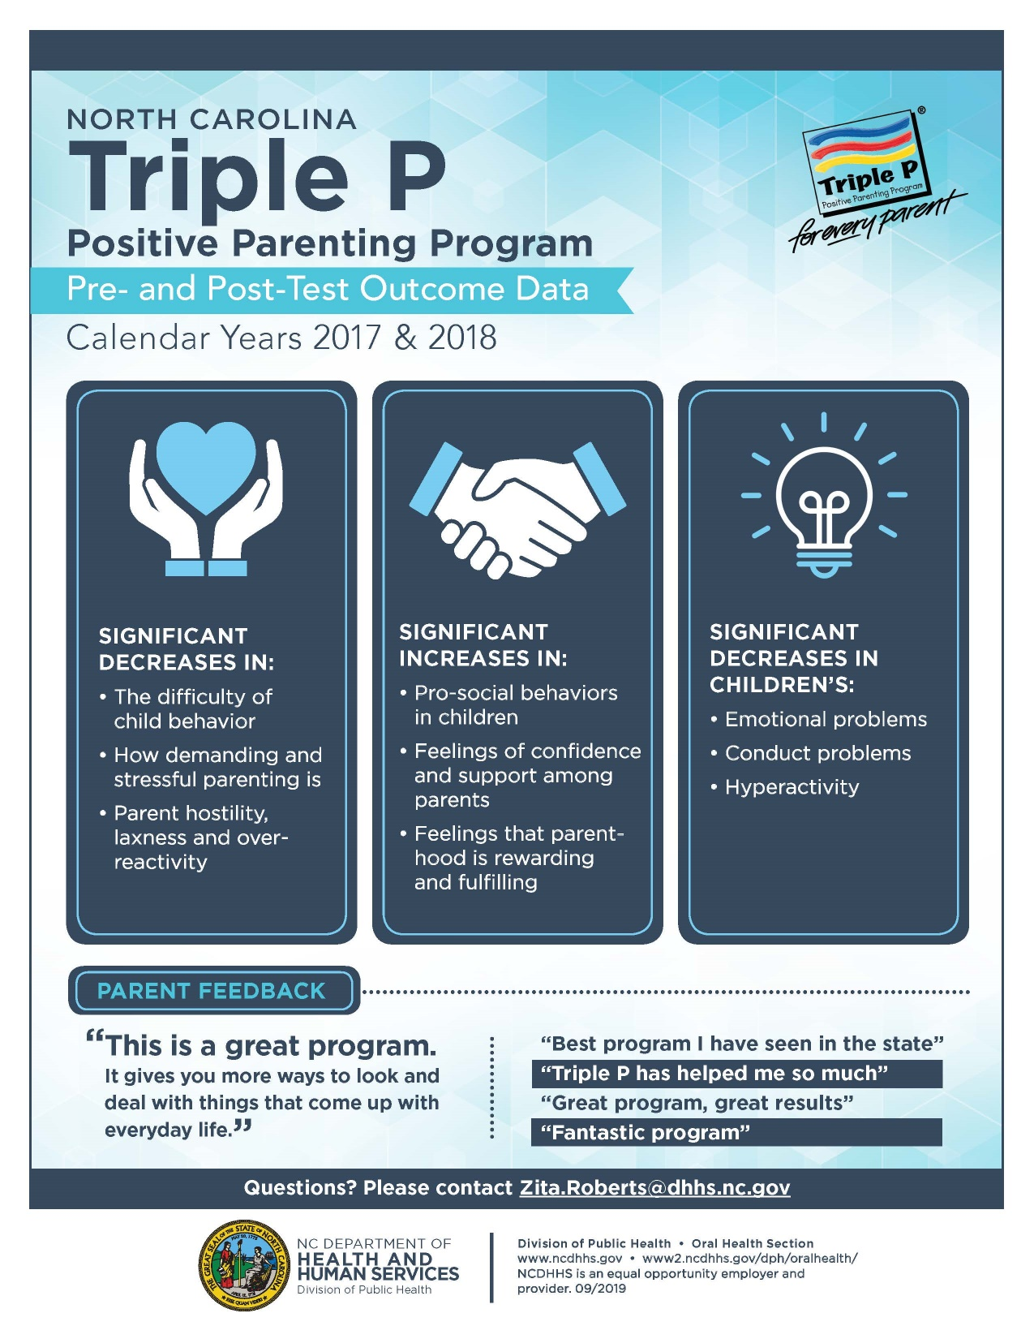

Slide 22
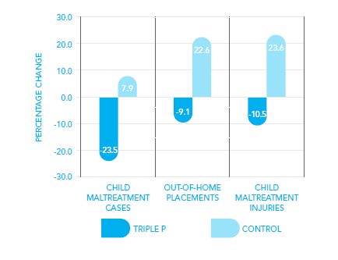
Population Level Effects
The CDC funded a trial in South Carolina introducing Triple P into 9 counties and comparing outcomes with 9 similar counties with care as usual. The results for the Triple P counties:
Prinz, R. J., Sanders, M. : R., Shapiro, C. J., Whitaker, D. J., & Lutzker, J. R. (2009). Population--based prevention of child maltreatment: The U.S. Triple P System Population Trial. Prevention Science,10(1), 1-12.
Prinz, R. J. (2017). Assessing child maltreatment prevention via administrative data systems: A case example of reproducibility. Child Abuse and Neglect, 64, 13-18.

Slide 23
Triple P Evaluation
California Evidence Based Clearinghouse
http://www.cebc4cw.org/
Blueprints for Healthy Youth Development
http://www.blueprintsprograms.com/
Office of Juvenile Justice and Delinquency Prevention
https://www.ojjdp.gov/mpg/
Washington State Institute for Public Policy
http://www.wsipp.wa.gov/BenefitCost
Title IV-E Prevention Services Clearinghouse (Families First Prevention Services Act)
https://preventionservices.acf.hhs.gov/

Slide 24
Key Aspects
Use of strength-based self-regulatory framework
Parents determine the goals
Practitioners use examples that are relevant to the family
A menu of parenting strategies
Practitioner helps the parent to make informed choices

Slide 25
Self-regulatory framework
Self regulation
Self-management
Self-efficacy
Personal agency
Self-sufficiency
Problem-solving
Reduced need for support
Minimally
Sufficient
Intervention

Slide 26
Principles of positive parenting
Ensuring a safe, interesting environment
Creating a positive learning environment
Using assertive discipline
Having realistic expectations
Taking care of yourself as a parent
Guiding themes present in all interventions
17 Core Parenting Skills
Age Appropriate Interventions (0-16 yrs) Babies | Toddlers | Pre-K | K | Primary | Teens
Notes:
Principles of positive parenting
Positive parenting is an approach to parenting that aims to support the healthy development and adjustment of children. It is based on good communication, positive attention and problem solving to promote positive family environments.
The five core principles include:
Making sure children have a safe, supervised and therefore protective environment that is stimulating, providing opportunities for them to explore, experiment, play, and interact with others.
Parents being available and encouraging their children to help them learn and develop by responding positively and constructively to child-initiated interactions (e.g., requests for help, information, advice, attention) to assist children to learn to solve problems for themselves.
Using consistent, predictable, assertive discipline to help children learn to accept responsibility for their behavior and become aware of the needs of others. Specific child management strategies are taught that are alternatives to coercive and ineffective discipline practices (such as shouting, threatening, or using physical punishment).
Parents having realistic expectations, assumptions, and beliefs about the causes of children’s behavior and choosing goals that are developmentally appropriate for the child and realistic for the parent.
Parenting is easier when personal needs as an adult are met, making it easier for parents to be patient, consistent and available to their children. Parents are encouraged to view parenting as part of a larger context of personal self-care, resourcefulness and well-being.

Slide 27
Strategies
Promoting Positive Relationships
Brief quality time
Talking with children
Encouraging Desirable Behavior
Descriptive praise
Positive attention
Affection
Engaging activities
Teaching New Skills and Behaviors
Guiding Children’s Behavior
Modeling
Incidental teaching
Ask, Say, Do
Behavior Chart
Ground rules
Directed discussion
Planned ignoring
Clear, calm instructions
Logical consequences
Quiet time
Time out

Slide 28

North Carolina Triple P

Slide 29
NC Triple P Infrastructure
What infrastructure exists?
Who are the partners at the table?
What are the state goals for Triple P in NC?

Slide 30
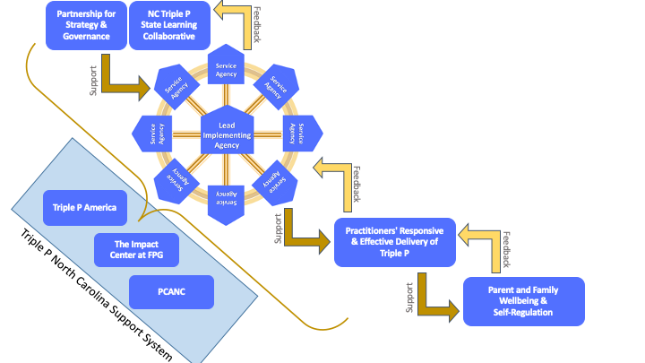
Triple P Infrastructure in NC

Slide 31
NC Triple P State Level Teams
Partnership for Strategy and Governance
NC Department of Health and Human Services
NC Division of Public Health
NC Department of Social Services
Duke Endowment
NC Partnership for Children
NC Mental Health
NC Juvenile Justice
LIA Representatives (2)
Parent Representatives (2)
North Carolina Learning Collaborative
Members include coordinators and supervisors from lead implementing agencies
Attendance from representatives from PSG and Support System
Stakeholders invited to attend as desired/relevant

Slide 32

PSG’s Role
The Triple P PSG is structured to ensure:
Strategy
Communication
Resources, and
Accountability for outcomes
Are aligned across state and local agencies as well as with their various partners.

Slide 33
Lead Implementing Agencies
Albemarle Regional Health Systems
AppHealthCare
Cabarrus Health Alliance
Cumberland Health Department
Durham County Health Department
Halifax County Health Department
MAHEC
Mecklenburg County Health Department
Pitt County Health Department
Project Enlightenment (Wake County)

Slide 34



Triple P Statewide Coverage
App District
Durham
Halifax
Albemarle
Madison
ASHE
ALLE-
GHANY
WARREN
NORTH-
AMPTON
GATES
CAM-
DEN
CURRITUCK
SURRY
STOKES
ROCKING-
HAM
CASWELL
PERSON
VANCE
HERT-
FORD
PER-
QUIMANS
WATAUGA
WILKES
GRAN-
VILLE
HALIFAX
PASQUO-
TANK
MITCHELL
YADKIN
FORSYTH
GUILFORD
ORANGE
FRANKLIN
BERTIE
CHO-
WAN
YAN-
CEY
AVERY
CALDWELL
ALEX-
ANDER
ALA-
MANCE
DURHAM
NASH
MADISON
IREDELL
DAVIE
DAVID-
SON
EDGE-
COMBE
WASH-
INGTON
DARE
BURKE
WAKE
WILSON
MARTIN
TYRELL
HAY-
WOOD
BUN-
COMBE
McDowell
CATAWBA
ROWAN
RANDOLPH
CHATHAM
PITT
BEAU-
FORT
SWAIN
RUTHER-
FORD
LINCOLN
LEE
JOHNSTON
GREENE
HYDE
GRAHAM
JACK-
SON
HENDER-
SON
CLEVE-
LAND
CABARRUS
MONT-
GOMERY
HARNETT
WAYNE
TRAN-
SYLVANIA
GASTON
MOORE
LENOIR
CHEROKEE
MACON
POLK
GASTON
MECKLEN-
BURG
STANLY
CRAVEN
PAM-
LICO
CLAY
CUMBER-
LAND
SAMPSON
JONES
UNION
ANSON
RICH-
MOND
HOKE
DUPLIN
SCOT-
LAND
ONSLOW
CARTERET
Mecklenburg
ROBESON
BLADEN
PENDER
COLUMBUS
NEW
HANOVER
Pitt
BRUNSWICK
Expand current LIAs to their contiguous counties
New LIA covering Sandhills/SE region
Cumberland
Cabarrus, a stand alone LIA, per agreement

Slide 35
Support System
Impact Center
Prevent Child Abuse North Carolina
Triple P America
State DPH and DSS Triple P Coordinators

Slide 36
Triple P Support System Roles
Prevent Child Abuse NC |  | Triple p America |  | Impact Center
Practitioner Coaching & Skill Building Communications Best Practices & Strategies Policy & Finance |  | Training and accreditation for Triple P practitioners Program resource materials for practitioners and parents Post-accreditation support Stay Positive materials Programmatic information and consultation Consultation on data/evaluation National policy advocacy |  | Implementation Site Support to LIAs and the Child Welfare System to: Building collaborative relationships Using interactive tools, resources, and learning to facilitate a co-created improvement process. Developing Goals, Strategies, and Early Wins to improve local capacity and performance. Reinforcing local self- regulation.
Notes:
PCANC –
Coaching Skills & Facilitation Skills
Peer Assisted Supervision and Support Model (PASS)
Supporting Virtual Delivery of Triple P
Supporting LIA staff in creating and facilitating skill-based trainings for Triple P providers
Creating and implementing a successful communications strategy
Effective storytelling
Building your elevator speech
Leveraging funding for Triple P
Funding Landscape
Advocacy
TPA –
through workshops, clinical consultation days, or clinical consultation calls
Triple P implementation knowledge and experience both nationally and globally
National policy advocacy to promote prevention and child and family well-being
Impact Center
Using a variety of interactive tools, resources, facilitation, and learning activities.
Focused capacity building efforts on co-creation, teaming, use of data, workforce supports, and media and networking.

Slide 37
What are the state goals for Triple P in NC?
North Carolina Triple P aims to reach 20-25% of families through service delivery of Triple P Levels 2-5. Additionally, North Carolina Triple P aims to reach 85% of the population through a primary prevention communications strategy
Build community and service delivery agency capacity in:
Co-creation Partners, Leadership and Implementation Teams, and Community Triple P Coalitions
Workforce Development Systems
Quality and Outcome Monitoring Systems
Media and Networking Systems

Slide 38
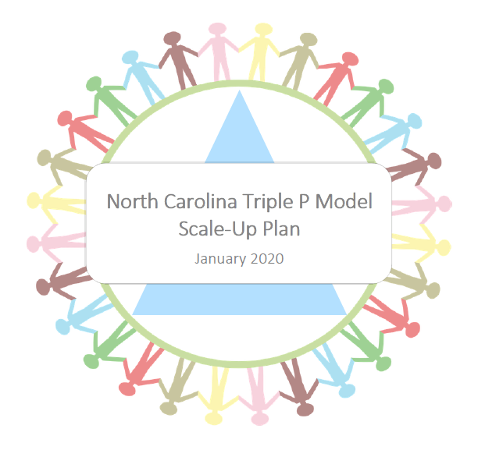
More details on the state goals for Triple P

Slide 39


Slide 40
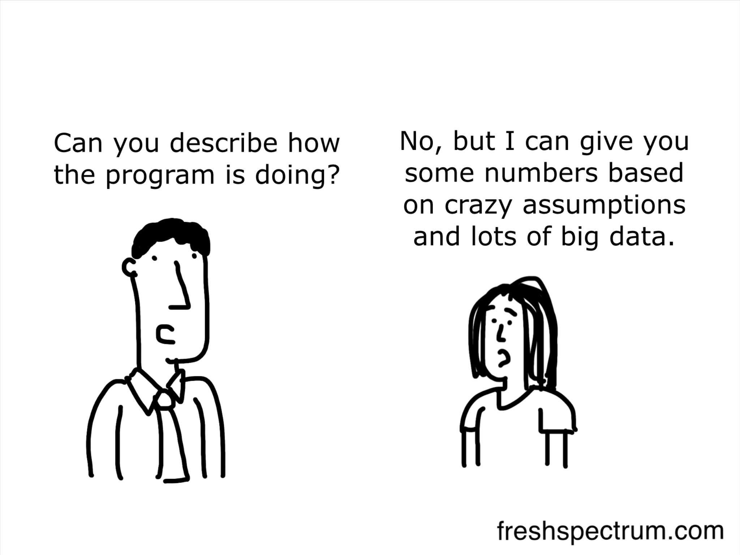
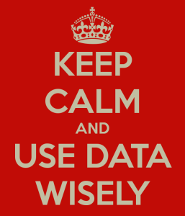
Using Data to Understand & Improve

Slide 41


What is a decision-support data system?
Get Data
Use Data
Notes:
In other words, it’s a process for systematically getting and using data.
Decision support = what do you do with it?
Data system = how you systematically get it?

Slide 42
Why do we care about decision-support data systems?
“…having the capacity to monitor and evaluate the impact of an innovation was strongly related to program assimilation and sustainability.”
Walker at al. (2015) Diagnostic & Evaluative Capacity
Notes:
You’ll notice I am not spending time today discussing the research behind the value of a DSDS. If you aren’t already drinking the KoolAid that data can help efforts across all phases of implementation or in a myriad of ways, I encourage you to review the slides from the QOMI section of the 2020 Foundational PD.

Slide 43
Support and improve the implementation of an innovation
What does that mean, functionally?
Identifying, collecting, analyzing, & reporting data
Practical and efficient collection
Valid and reliable data
Disaggregate
System-wide learning and improvement
Continuous quality improvement
Ongoing learning
Feedback loops
Quality of implementation
Alignment with organizational goals
Notes:
The purpose of a DSDS is to …

Slide 44

ICO4MCH Reporting Requirements
By: Joe Hutchinson

Slide 45
Reporting Requirements Under ICO4MCH Agreement Addendum
For each evidence-based strategy implemented, quarterly reports should include the following information:
1. Number of individuals (or families) served, stratified by demographic variables such as age, gender, insurance status (Medicaid/Private/Uninsured), and racial/ethnic group (non-Hispanic white, non-Hispanic African American, non-Hispanic Native American/American Indian, non-Hispanic other, and Hispanic) and other demographics, as appropriate.
2. Challenges encountered
3. Successes encountered
4. Trainings and professional development opportunities
5. How health equity is addressed within each evidence-based strategy, and
6. Next steps.
Please note the demographic data being collected may differ by service area, as each ICO4MCH site is required to develop its own workplan, including how to make the implementation of Triple P services more equitable.

Slide 46
Why it is Important?
ICO4MCH is supplementing Title V funds for the expansion of Triple P services and in certain areas and requires additional reporting of demographic data to ensure equitable delivery of the intervention in the areas the funding is supplemented; failure to report at all or report with the supplemental demographic data may jeopardize refunding of the ICO4MCH grant in upcoming grant cycles and reduce the overall availability of Triple P services in the regions receiving ICO4MCH grant funds.

Slide 47





DATA COLLECTION IN THE DURHAM REGION

Slide 48

How we collect Data:
Paper Logs Quarterly Survey
Customized Excel Spreadsheets

Slide 49
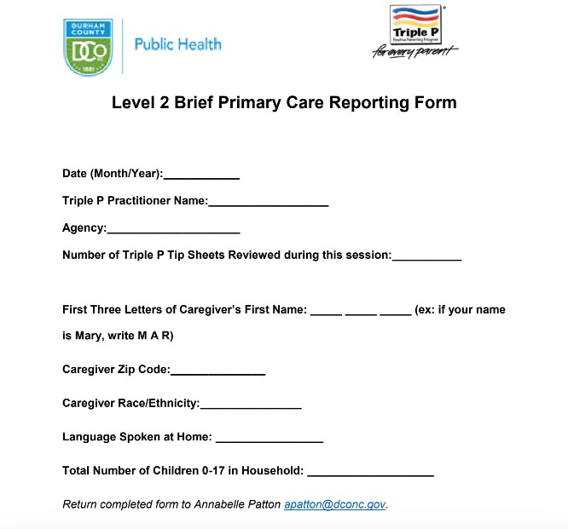

Slide 50
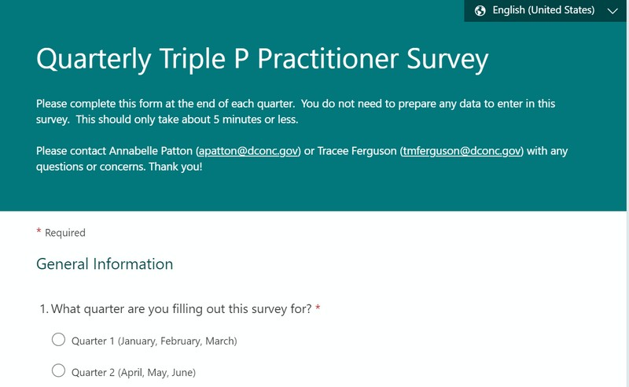

Slide 51
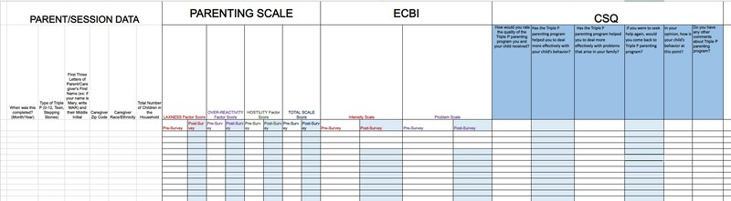

Slide 52
Additional Data We Collect:
Race/Ethnicity of caregiver Zip Code
*Language Spoken at Home
*Language Used in Session
Barriers to Conducting Triple P Sessions

Slide 53
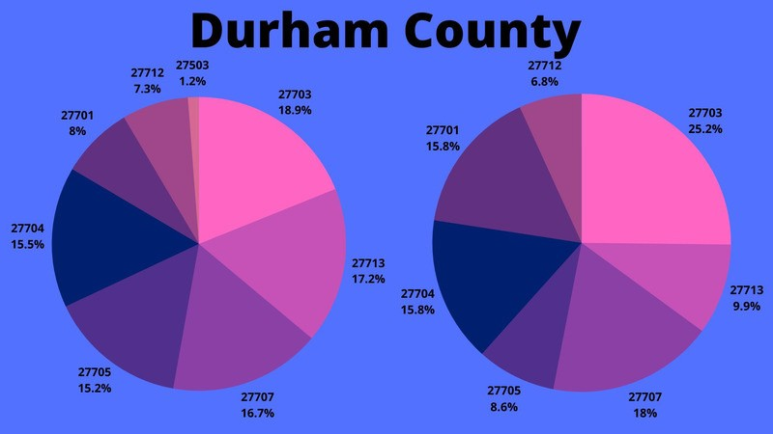
How we use this data:

Slide 54
Other ways we use this data:
Influences how we support agencies/practitioners currently, and how we plan to support them moving forward
How to reach families that aren't currently being reached by Triple P

Slide 55
QUESTIONS?
Annabelle Patton
Triple P Data Specialist- Durham Region apatton@dconc.gov

Slide 56
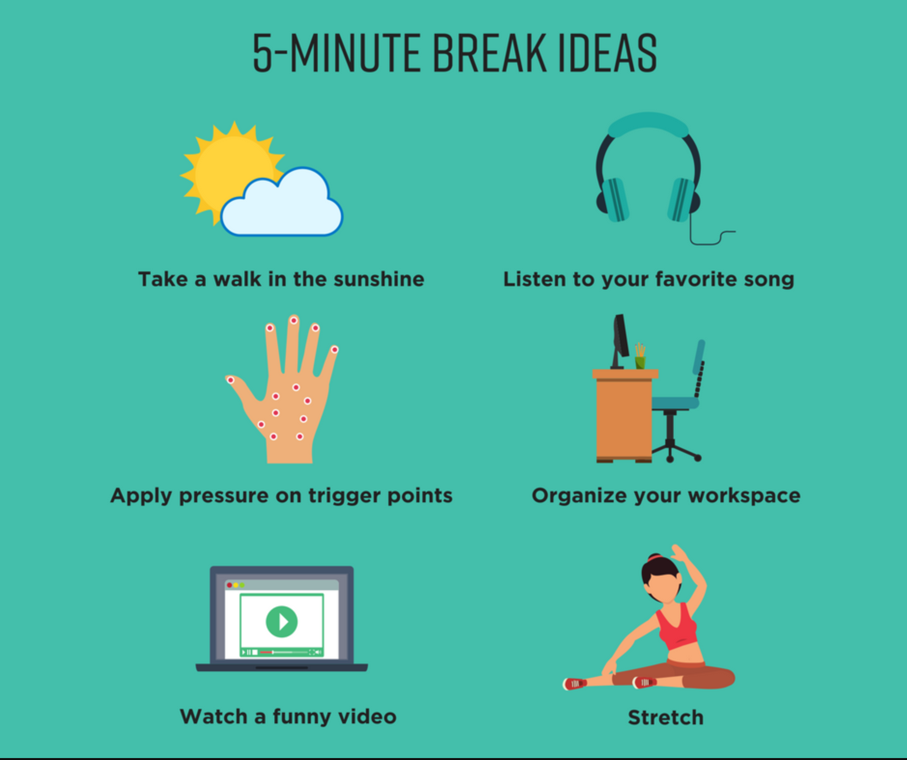

Slide 57
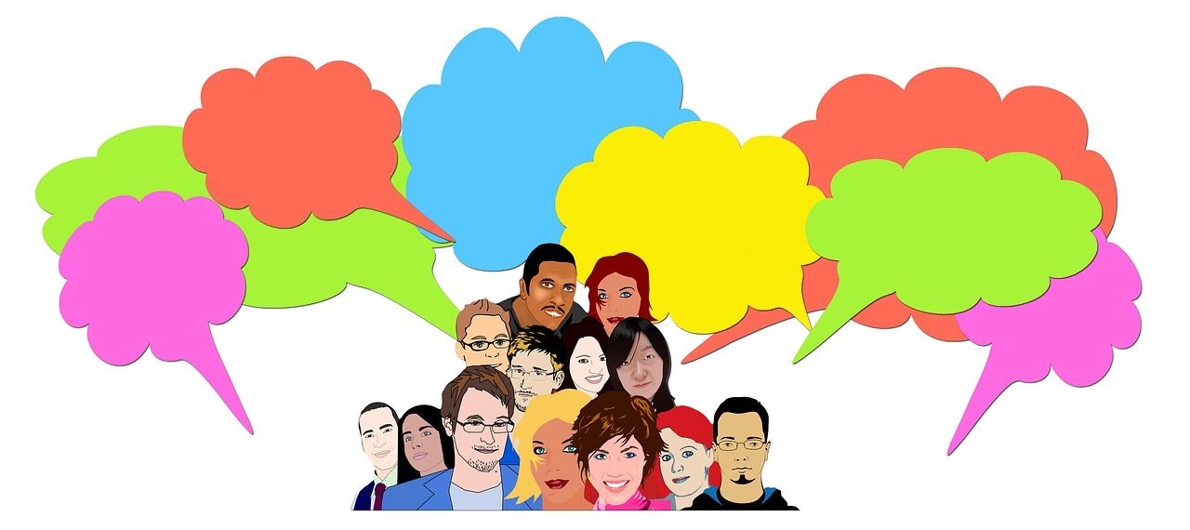
Peer Support Time

Slide 58
Small Group Breakouts
A success you want to share
A challenge you need support for.
Notes:
15-20 mins breakout – jamboard link: https://jamboard.google.com/d/1S_dTEM3IzrrJcAqnLpJMh0uZiYU8fBQTAKTmYG_kCtg/edit?usp=sharing
Prompting to say this is intended for SDAs. If LIA is in a group or a partner either lean back and prompt these questions of SDAs or post something you have heard from a SDA as a challenge. Prompt people – Shannon – be aware of learning styles & lean in or lean back.
Even if you are not implementing Triple P, think about your agency and challenges or questions that may arise.
For your group, we encourage folks to provide relevant context/information about the problem – focusing on not just what it is but what may be contributing to the problem. Really ensuring folks have clarity on what you want support on. Encourage each other to elaborate, if you need more info to get to clarity/understanding.
Post-its for us to add to the jamboard, if needed: https://jamboard.google.com/d/1S_dTEM3IzrrJcAqnLpJMh0uZiYU8fBQTAKTmYG_kCtg/edit?usp=sharing
People I sent to training are no longer here or aren’t using Triple P.
Time to engage in peer-to-peer or coaching supports – needing to be responsive vs. create proactive space.
Families not fully engaging in the program – not meeting their needs/too intensive.

Slide 59
Peer-to-Peer Support
Consider sharing:
What’s been your biggest Triple P challenge in the last 6-12 months?
What are you least clear about related to Triple P?
What is one small or big success that deserves a shout out.
What is one small step you have taken towards taking on Triple P or improving Triple P delivery?

Slide 60
Group Report Out
Successes & Strategies Shared:

Slide 61
Individualized Support Access
Prevent Child Abuse NC
Coaching/Peer Support
Triple P America
Programmatic Expert
Impact Center
Implementation Design/Consultation
The aim of the Support System is to partner with local communities to gradually build sustainable resources, abilities, and performance that support the local use and scale up of Triple P.
Notes:
“In a survey of 400 organizations, Deloitte and Touche (1996) found that employees’ resistance to change is the number one reason why organization change initiatives fail. Many times resistance is caused by poorly planned implementation of change initiatives (Winum, Ryterband, & Stephensen, 1997; Conner, 1992). A common mistake made by leaders is to think that because they are now ready to take action, they can impose action initiatives on employees who are not prepared.” Prochaska et al. (2001, p. 253)

Slide 62
Resource Toolkit
Triple P 1-pagers
Triple P Level Descriptions
Archived Triple P Brief Newsletters
TPOL Info
Is Triple P Right for Us?: An Agency Assessment
LIA map
Presentation Materials
Collaborative Listserv
Individual Agency Technical Assistance

Slide 63
Waterfall Chat
One idea I am leaving with or plan to try…

