Slide 1
NC CHILD WELFARE TRIPLE P LEARNING COLLABORATIVE
Facilitator:
Christina DiSalvo, Implementation Specialist
Impact Center at FPG, UNC-CH
May 12, 2021

Slide 2
Objectives
Build awareness of NCDSS Triple P investments
Learn how ongoing readiness activities can support Triple P implementation
Review of available supports
Discuss future collaborative topics of interest
Notes:
Poll – 1st to learning collaborative; back again to learn more.
Who – supervisor, social worker, program manager, executive director, NC Triple P partner
Best practice overview
Panel presentation
Q&A session

Slide 3
Where Are We Going?
Increased awareness of Triple P and fit with child welfare needs.
Increased knowledge of practices and structures that support successful program delivery.
Increased use of implementation tools, resources, and support.
Notes:
Learning is the process that enhances knowledge, which is the capacity for effective action. Therefore, for organizations to be successful, individuals must have opportunities to share their learning with others. Through collaborative reflection and dialogue, participants can develop new constructions of what was, what is, and what needs to be.
Objective today – Increased awareness of Triple P & fit and feasibility considerations for CW.
Poll – Role
Poll – Participation

Slide 4
Guiding Principles
Guiding Principles
Our Values
Creating a safe space for learning together
Peer-to-peer support
Enhancing service through practice
Responsive supports adapted to context/needs
We welcome different perspectives because it drives conversation.
We understand people have different levels of readiness and that supports learning through the sharing of successes, challenges, and ideas.
We acknowledge those we serve and agencies we work in are different, but those differences allow us to focus decision-making on what works best for the families and the workforce supporting them.

Slide 5
NCDSS Triple P Investments
Family First Prevention Services Act (FFPSA)
Victims of Crime Act (VOCA)
Family Support Request for Applications
Implementation Support through UNC-CH

Slide 6
“Readiness” is a developmental point at which a person, organization, or system has the capacity and willingness to engage in a particular activity. It needs active support to be built, nurtured, and sustained.
Notes:
How do we define it? It is not a pre-existing condition waiting to be found or an enduring aspect of a person, organization, or system.

Slide 7
Reflect on a time when your agency took on a new initiative or change. What factors either facilitated or limited your organization’s readiness to engage?

Slide 8
Motivation & Ability
Are we motivated to make a change?
Do we have the ability to make the change?
Agency level: assessing staff time and accessibility to resources needed to implement the program or practice well.
Family level: assessing things that can impact overall family stability (e.g. mental health issues, history of trauma, time to commit to support)
Agency level: assessing leadership buy-in, staff belief that Triple P is a benefit to the families they serve and is better than their typical approach to support.
Family level: motivation to enhance their parent-child relationship through the use and practice of new strategies.
Notes:
When it comes to a parenting program, sometimes it is nice to acknowledge we do a lot of work to ready a family to effectively participate in a program, but we don’t always take the time to do that work internally when taking on something new.
Creating and nurturing readiness is all about making sure folks are willing (motivated) and able (have the capacity) to participate in the change. When we say change here, we mean incorporating a new practice into local child welfare service delivery, Triple P.
So, let’s keep going with this parallel. At, the family level when thinking about motivation, its likely not enough to just say your mandated to do Triple P. You want to introduce the program and talk about its benefits to assess their desire to enhance their child-parent relationship through the use and practice of new strategies. Let’s flip that now to the agency level, its probably not enough to say Triple P is what we plan to do, rather ensuring leadership and staff buy-in that they see the program being a benefit to the families they serve and can enhance overall services.
For ability, there would be some concrete things you may want to ensure at the family level to make sure they can participate. So things that might impact overall stability and ability to fully participate. This may be time to commit or services that may be needed prior to participation. At the agency level, when thinking about do we have the ability to implement Triple P, it could be ensuring staff have caseloads that allow them to incorporate a new program into HVs or time to engage in discussions about what is going well, what is a challenge, or ongoing coaching supports.

Slide 9
Components of Readiness
Notes:
Readiness shouldn’t solely be seen at the individual level, rather when implementing a new program, readying the agency so there is collective motivation/shared resolve to implement Triple P and belief the ability to do so among members is really what we are talking about. Readiness is expected to by high when organizational members know what to do and how to do it, when they perceive they have the resources they need to implement the change, and when they perceive situational factors such as timing to be favorable. When readiness is high, organizational members are more likely to initiate the change, put forth greater effort in support of the change, and exhibit greater persistence in the face of obstacles.
Readiness is ever changing construct, impacted by competing priorities, climate, and may look different across an agency (role/placement in the agency). That is why it is critical to pay attention to it not just at the start of implementing Triple P, but throughout your implementation efforts. An organization’s capacity to support change includes the organization’s infrastructure, material resources, and leadership support for the new activity; it also includes employees’ perceptions of the overall “climate” of the organization in terms of commitment to quality improvement and support for staff to make individual and collective changes to practice.

Slide 10
Components of Readiness
Notes:
Not enough to be able to be able to do something, have to be willing or motivated as well. On the other side, its not enough to be motivated, capacity is critical for the change to be successful and sustainable. These are inter-related, not having one of them doesn’t exclude you from being ready, but knowing the components allows you to think about strategies that you might want to think about to ensure your Triple P efforts are effective.
HIGH: More likely to initiate change, exert greater effort, exhibit greater persistence, and display more cooperative behavior.
LOW: More likely to view the change as undesirable and subsequently avoid, or even resist, planning for the effort and participating in the change process.

Slide 11
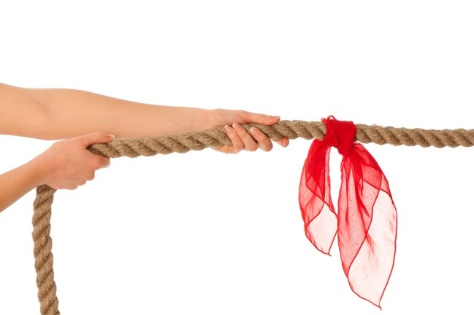
Resistance or Lack of Readiness?
Common experiences that impact readiness:
Turnover at any level
Competing priorities
Lack of leadership support
Lack of communication
Crises (large or small)
Things that indicate a lack of readiness:
Work is stalled
Work is not getting done outside of meetings
Notes:
Building off of the slide before, lack of readiness can show up as resistance, apathy, or stagnation. One great Triple P example is staff are accredited to deliver, but they aren’t doing so on a regular basis. Or, you aren’t getting the right or enough referrals. While there may be multiple things that could impact delivery and referrals, some of it is directly tied to readying your agency for change. Did SWs have adequate time to deliver; do their supervisors know the program to promote it and check in to support and hold the SW accountable? Are referring SWs aware of the program; do they know what families are best served?
Those are just a few examples, but other things can impact readiness – regular turnover can cause loss in trained staff or leadership support; staff are called on to put their energy elsewhere, so Triple P is not seen as a priority. Responding to crisis or multipe crisis, often prevents focus and limits time.

Slide 12
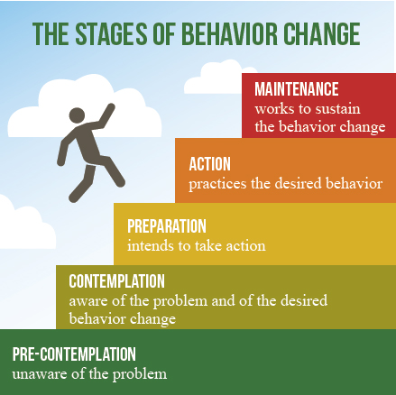
Resistance or Lack of Readiness?
One conjures feelings of frustration.
Potential for increased pressure, stress and uncertainty.
Reframe it!
Signal to look deeper
Anticipate it, design for it, respond to it.
Be prepared to meet folks where they are.
Notes:
Organizational change asks staff and stakeholders to shift from the known to the unknown. Reaction may be to the situation they find themselves in. They may have uncertainty and apprehension. Or, perhaps they are experiencing change fatigue – constantly shifting from managing to planning, preparing . . . REPEAT Good leadership and support partners recognizes this. By assessing readiness for change, leaders and support folks can identify gaps that may exist between their own expectations about the change effort and those of other organizational members.

Slide 13
Nurturing Ongoing Readiness
COMMUNICATION FOR ENGAGEMENT!
Actively ensuring that people see how Triple P fits.
CLIMATE FOR “CHANGE” IN THE ORGANIZATION IS SET!
People get to learn together, try together, and share examples of early practice together.
Leaders are demonstrating their role in supporting Triple P - Visible commitment!
Gathering feedback to figure out how to document data to track progress and improvement.
Engaging people to help them really see Triple P as it applies to them.
People are asked what resources and supports they need to get and stay ready.
Notes:
Team meetings about Triple P – what it is and how it may look in the agency. Hearing for others about how it is implemented. Will they refer to Triple P? deliver Triple P, Supervise and support a Triple P delivering or referring SW?
Having a discussion about how you will know if Triple P is being delivered as intended – dosage, quality of delivery – competence of the SW and adherence with the core components, family’s participation and success, longer-term outcomes.
This is really related to having a teaming structure that allows for ongoing peer support and discussion of successes and challenges. This can be supplemented through external meetings like Lead Implementing Agency supported coalition meetings or coaching sessions. This is more than the practitioners though, this is a cross-team, multi representative team.
Leaders not just saying we support Triple P but actively show up – at team meetings and celebrate successes or help with challenges. Call out good practice individually. Talk about Triple P at broader meetings.
People are asked what they need, not just told. This means being intentional about creating ways to make that happen. Is it a survey, is it a team meeting, is it individual conversations. Or all of those. The important thing is ensuring people know there is an opportunity to share and something is done with the information. It is also important to ensure you are always asking who is missing. We don’t have the front desk staff here, yet they may get calls or could help promote the program – what do they need? How might we include the voice of the family?

Slide 14
Nurturing Ongoing Readiness
PEOPLE UNDERSTAND WHAT THEY NEED TO DO & FEEL SUPPORTED
The organization sets up ways to pay attention to & help staff deliver Triple P in day-to-day work.
TEAMS HAVE CLEAR, DEDICATED, RESOURCED ROLES FOR IMPLEMENTATION
There are people with specific roles to facilitate day-to-day coordination & management of implementing Triple P.
The organization is thinking about what to watch for and how to learn from what they see to get better.
People perceive they have the resources they need to feel confident and competent.
Teams understand their specific purpose and how they connect to the work of other teams.
Teams are linked to each other, leadership, staff, and partners in ways that fit local context.
Notes:
How will you know it is being delivered; how is space being created to try Triple P on, knowing that it may be slow and awkward at first or challenging situations come up. Is it through case staffing in a team setting; individual supervision discussions; attendance at coaching sessions.
Such a value to have a supervisor trained in Triple P so you can observe and ask the right questions. When staff are challenged, knowing what supports are available and how to access them. That it is framed in a growth stance, not compliance/disciplinary focused.
Staff know they have the support of their peers (team mates/referring SWs, supervisor, leadership) and external supports. They also feel like they have adequate time and support for using those supports for ongoing improvement.
There is a team that is charged with ensuring the rollout, coordination, and management of Triple P is attended to. You could use an existing team, but this is the team accountable for Triple P in the agency. Not one person, because multiple voices are needed to ensure effective coordination.
Internally – is there a leadership or management team that needs to be linked to the Triple P work for ongoing communication, strategy development, and problem solving. Does that communication go both ways – Leadership giving feedback back or letting the other team know when other things may impact Triple P delivery. Are you linked to external teams supporting the work broadly across the community to ensure alignment in services, learn from one another, and inform scale up and support efforts at a regional level.

Slide 15
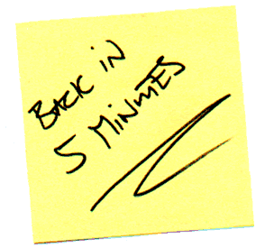
Break Time

Slide 16
Readiness Panel:
Jennifer Evans
Supervisor-Placement & Behavioral Health
Wake County Human Services
Jason Mahoney
Child Welfare Program Manager
Wake County Human Services
Tondrea Leach
Executive Director
Onslow County PEERS Family Development Center
Linda Collins
Child and Family Team Facilitator & LINKS Coordinator Richmond County Department of Social Services
Sara van Driel
Implementation Consultant
Triple P America
Notes:
Pause for Q&A time.

Slide 17
Accessing Support
Your Local Implementing Agency
The DSS Implementation Support Specialist, Christina DiSalvo, christina.disalvo@unc.edu
Triple P America, Sara van Driel, sara@triplep.net

Slide 18
Resource Toolkit
Increased awareness of Triple P and fit with child welfare needs.
Increased knowledge of practices and structures that support successful program delivery.
Increased use of implementation tools, resources, and support.
Readiness 1-Pager
Learning Collaborative Recordings
Newsletter Archives
LIA Support
Impact Center Implementation Support
Agency Fit & Feasibility Assessment
Triple P Level Descriptions
TPOL Info
Peer-to-Peer Learning

Slide 19
What Questions Do You Have?
Let us know on the Jamboard!
https://jamboard.google.com/d/1yppLsp2uA6POZFwI4XrBkQMDW50hysy1yoTL_O1udxE/edit?usp=sharing
Notes:
Poll - topics

