Slide 1
NC CHILD WELFARE TRIPLE P LEARNING COLLABORATIVE
Presenters:
Christina DiSalvo, Impact Center at UNC’s FPG Institute
Alexa Hamel, Orange County DSS
Sara van Driel, Triple P America
February 9, 2021

Slide 2
Where Are We Going?
Increased awareness of Triple P and fit with child welfare needs.
Increased knowledge of practices and structures that support successful program delivery.
Increased use of implementation tools, resources, and support.
Notes:
Learning is the process that enhances knowledge, which is the capacity for effective action. Therefore, for organizations to be successful, individuals must have opportunities to share their learning with others. Through collaborative reflection and dialogue, participants can develop new constructions of what was, what is, and what needs to be.
Objective today – Increased awareness of Triple P & fit and feasibility considerations for CW.

Slide 3
Why?
How?
You will have a greater understanding of the Triple P system, evidence, and implementation process.
Support System will have a better understanding of your interest in Triple P and goals you want to achieve through program delivery.
Collectively we will all have a clear understanding of child welfare agencies’ willingness and ability to deliver the program as intended and what supports may be needed to bolster quality implementation overtime.
Initial learning about the suite of Triple P programs.
Share information about Triple P supports.
Exploring desired outcomes.
Exploring potential fit for Triple P for:
Children and families
Your agency & staff who will be delivering the program.
Notes:
To individually and collectively increase our awareness and understanding and to develop new perspectives. Groups engage in learning together to better understand an experience, situation, system, issue, or opportunity, as well as understand different, and potentially competing, perspectives.
To generate new ideas and/or solutions. Groups engage in learning to identify and/or refine ideas that could inform planning, design, or implementation; this might include generative discussions about solutions and possible actions.
To make important decisions. Groups engage in learning to reach consensus or agreement on a path forward.

Slide 4
Getting to know you
What’s Your Role?
What part of the state are you from?
Familiarity of Triple P
This Photo by Unknown Author is licensed under CC BY-SA-NC
Notes:
Launch poll questions

Slide 5
Guiding Principles
Guiding Principles
Our Values
Creating a safe space for learning together
Peer-to-peer support
Enhancing service through practice
Responsive supports adapted to context/needs
We welcome different perspectives because it drives conversation.
We understand people have different levels of readiness and that supports learning through the sharing of successes, challenges, and ideas.
We acknowledge those we serve and agencies we work in are different, but those differences allow us to focus decision-making on what works best for the families and the workforce supporting them.
Notes:
Question in the chat - “What would keep you engaged?” – Sara to monitor.

Slide 6
Typical Approaches
Where are we going?
Traditional Ways of Getting There…
Providing information
Training
Passing laws or mandates
Providing funding
Program or Practice
Child & Family
Outcomes
Only 5-15%!
Notes:
Question - “What do you think are some common ways we try to ensure a program reaches the outcomes it intends?”
Diffusion and dissemination of information
Training
Passing laws, mandates, or regulations
Providing funding or financial incentives
Organization change initiatives

Slide 7
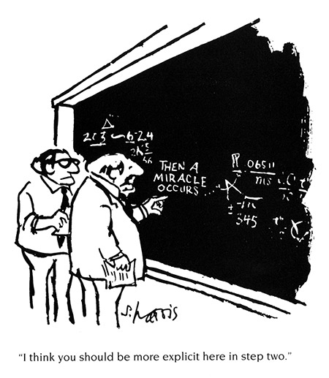
Better Approach
Ok, so…What do we do different?
Program or Practice
Child & Family
Outcomes
The “How”
Notes:
Question in the chat – “Reflect on a time when your agency took on a new initiative or change. What factors either facilitated or limited success.” – sara to monitor

Slide 8
What do we mean by “implementation”??”
“A process involving multiple decisions, actions, and corrections to change the structures and conditions necessary to successfully implement and sustain new programs and innovations.”
(SISEP, n.d.)
Notes:
State Implementation and Scaling-up of Evidence-based Practices Center (n.d.). Module 1: An Overview of Active Implementation Frameworks. Retrieved from FPG Child Development Institute, University of North Carolina, Active Implementation Hub website: http://implementation.fpg.unc.edu/module-1.
It’s about taking the time to think through the environment that needs to be created to ensure the use of Triple P is delivered well and sustainably.

Slide 9
Is Triple P Right for You?
Evidence
Usability
Supports
Fit
Capacity
Need
Agency
Considerations
Program
Considerations
Notes:
There is a lot of research around approaches that are shown to be effective in supporting good implementation of a program or practice. What our goal in this collaborative is to start learning together about how some of these approaches can be used by child welfare agencies with Triple P. So, really trying to see how these practices can be translated within the child welfare setting so they become usable.
We are going to pace how and what we are learning, because we know we have a lot of variability in knowledge of Triple P. So we are starting with how do you determine Triple P is right for your agency (whether you want to explore delivering it yourself or referring out to a Triple P service agency).
There are 2 pieces of the puzzle here for understanding how a program fits into an implementing site’s existing work and context. You have to explore Triple P (the program) and your agency.
We are going to start with a foundational presentation on what Triple P is spending some time discussing the evidence behind the program, its core components/principles, and available supports (think training/TA/consultation/coaching/other local requirements).

Slide 10
The Triple P System

Slide 11
What is Triple P?
The Triple P – Positive Parenting Program® is a system of evidence-based education and support for parents and caregivers of children and adolescents.
Population Health Approach
Tailored support for every family
30 + Years and Counting
Supported by extensive research base
Proven Results
Improves parenting skills and confidence
Notes:
The Triple P model was developed by Professor Matt Sanders at the University of Queensland over 35 years ago and continues to be evaluated and tested to this day. What started as an approach for families in need of intensive support has progressed to a public-health model with a population-level approach—designed to support the needs of every parent.

Slide 13
To achieve …
For children
Improved behavior and social emotional skills
For parents
Decreased stress, anxiety, and depression
For community
Decreased out-of-home placements
Better self-regulation
Improved health
Better parent-child relationship
Increased confidence and competence in parenting
Better parent-child relationships
Decreased child maltreatment cases
Decreased child maltreatment injuries
Improved health
Decreased juvenile justice cases

Slide 14
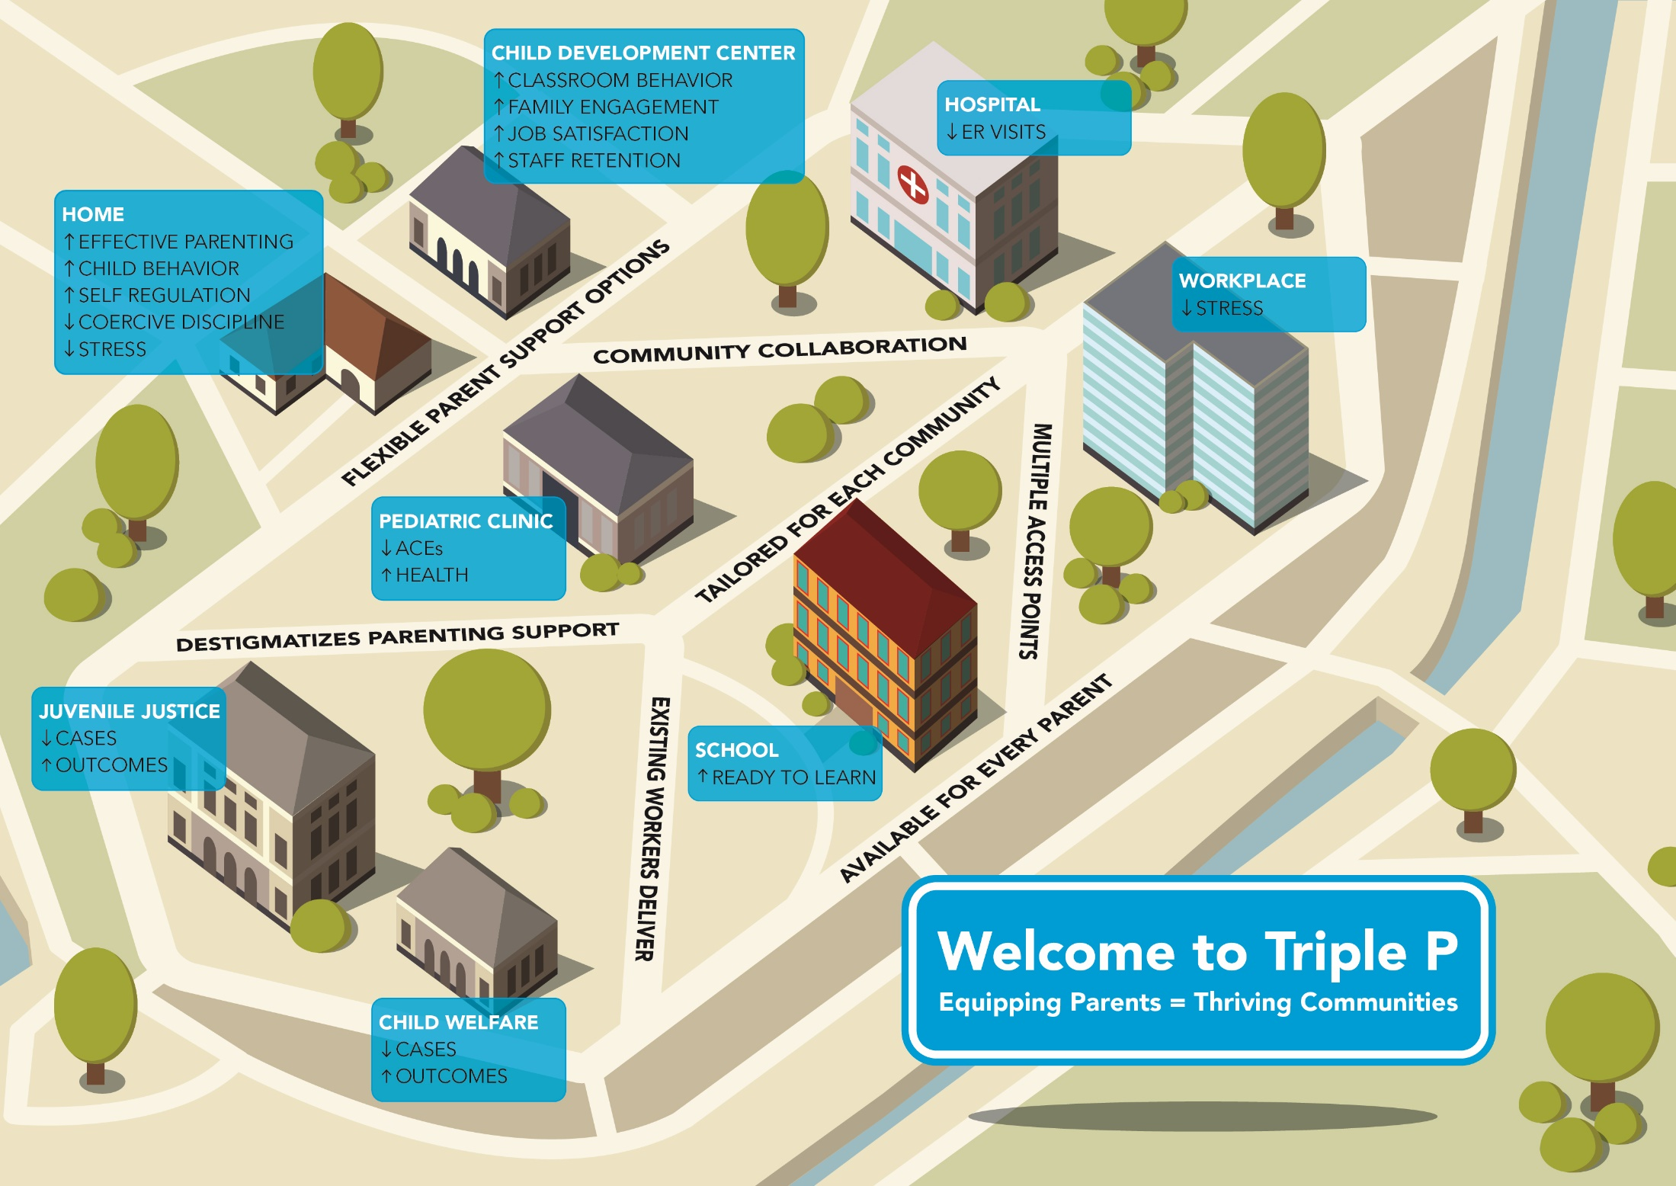

Slide 15
Key Aspects of Triple P
Use of strength-based self-regulatory framework
Parents determine the goals
Practitioners use examples that are relevant to the family
A menu of parenting strategies
Practitioner helps the parent to make informed choices

Slide 16
Principles of positive parenting
Ensuring a safe, interesting environment
Creating a positive learning environment
Using assertive discipline
Having realistic expectations
Taking care of yourself as a parent
Guiding themes present in all interventions
17 Core Parenting Skills
Age Appropriate Interventions (0-16 yrs) Babies | Toddlers | Pre-K | K | Primary | Teens
Notes:
Principles of positive parenting
Positive parenting is an approach to parenting that aims to support the healthy development and adjustment of children. It is based on good communication, positive attention and problem solving to promote positive family environments.
The five core principles include:
Making sure children have a safe, supervised and therefore protective environment that is stimulating, providing opportunities for them to explore, experiment, play, and interact with others.
Parents being available and encouraging their children to help them learn and develop by responding positively and constructively to child-initiated interactions (e.g., requests for help, information, advice, attention) to assist children to learn to solve problems for themselves.
Using consistent, predictable, assertive discipline to help children learn to accept responsibility for their behavior and become aware of the needs of others. Specific child management strategies are taught that are alternatives to coercive and ineffective discipline practices (such as shouting, threatening, or using physical punishment).
Parents having realistic expectations, assumptions, and beliefs about the causes of children’s behavior and choosing goals that are developmentally appropriate for the child and realistic for the parent.
Parenting is easier when personal needs as an adult are met, making it easier for parents to be patient, consistent and available to their children. Parents are encouraged to view parenting as part of a larger context of personal self-care, resourcefulness and well-being.

Slide 17
Strategies for promotion and development
Promoting Positive Relationships
Brief quality time
Talking with children
Encouraging Desirable Behavior
Descriptive praise
Positive attention
Affection
Engaging activities
Teaching New Skills and Behaviors
Modeling
Incidental teaching
Ask, Say, Do
Behavior charts
Notes:
Question for chat – “As we are reviewing strategies, think about the population you serve. What are some of the needs that the families have related to parenting?” – Alexa to monitor

Slide 18
Strategies for managing misbehavior
Ground rules
Directed discussion
Planned ignoring
Clear, calm instructions
Logical consequences
Quiet time
Time out

Slide 19
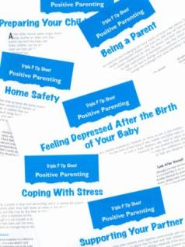
Level 3 – Primary Care Triple P
Brief, flexible parent consultation
Targets a specific behavior or developmental concern
Typically provided to parents in 4 individual sessions (15-30 minutes in duration)
Includes active skills training for parents

Slide 20
Level 4 Triple P
Who is it for?
What formats are available?
A moderately intensive parent program for moderate to severe behavioral or emotional difficulties
Can also be used as a primary prevention strategy to promote positive development
Teaches a broad range of parenting skills and focuses on generalizing use of skills across different behaviors and settings
Standard
10 individual sessions
Group
5 2-hour group sessions; 3 individual phone calls
Self-Directed
Self-help workbook
Online
8 self-paced modules online

Slide 21
Staffing and Cost Considerations
Staffing
Which staff has parents that could benefit from Triple P? Parents who would benefit from improved confidence and competence in parenting skills as well as the capacity to engage in parenting support. Is Level 3 or Level 4 a better fit?)
Does that staff have the capacity (skills and time) to deliver Triple P to families? What other job duties does the staff have to perform? Do they have interest in providing parenting support for building parenting skills? Do they have experience or education in providing parenting support? Do they have time to engage in peer support and coaching for Triple P?
How many staff from your organization can deliver? Research shows that having at least 3 staff trained leads to a 9 times great chance of sustainability.
Costs
Training and parent materials
Connect with your Lead Implementing Agency
Potential opportunities for DSS organizations through DSS RFP and VOCA
Staff time for training, engaging parents/recruitment, delivery, coaching and support, data collection

Slide 22
NC Triple P System
Notes:
Lead Implementing Agency – consistent, ongoing support to various service delivery agencies including DSS. Charged with supporting a community led approach to expanding and supporting Triple P across a service area. This typically translates to involving a variety of co-creation partners in developing strategies that will achieve expansion & support goals. It also is targeted supports around recruiting and selecting service delivery agencies, training offerings, ongoing coaching, media & networking (focused on normalizing parenting support & awareness of available services), and data collection.
Support System – made up of several partners help support LIAs and DSS agencies with building their knowledge and use of implementation approaches that, when put into practice help ensure Triple P is optimized in a community – meaning the program is accessible & reaches those who may benefit, its appropriate for those it serves, it is seen as a useful support by families, and those who deliver the program are delivering the way it was intended. Only then, do we hope to see those more long-term outcomes we know Triple P can have.

Slide 23
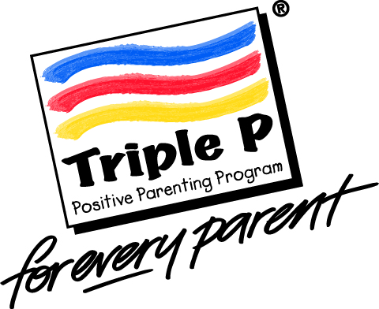
Primary Funders:
What does Triple P look like in North Carolina? The infrastructure, funding, and partnerships
Statewide regional coverage coordinated by lead implementing agencies
ASHE
ALLE-
GHANY
SURRY
STOKES
WARREN
NORTH-
AMPTON
HERT-
FORD
GATES
CAM-
DEN
CURRITUCK
ROCKING-
HAM
CASWELL
PERSON
VANCE
PER-
QUIMANS
WATAUGA
WILKES
GRAN-
VILLE
HALIFAX
CHO-
WAN
PASQUO-
TANK
MITCHELL
YADKIN
FORSYTH
GUILFORD
ORANGE
FRANKLIN
BERTIE
YAN-
CEY
AVERY
CALDWELL
ALEX-
ANDER
DAVIE
ALA-
MANCE
DURHAM
NASH
EDGE-
COMBE
MADISON
IREDELL
DAVID-
SON
WAKE
MARTIN
WASH-
INGTON
TYRELL
DARE
HAY-
WOOD
BUN-
COMBE
McDowell
BURKE
CATAWBA
ROWAN
RANDOLPH
CHATHAM
WILSON
PITT
BEAU-
FORT
GRAHAM
SWAIN
HENDER-
SON
RUTHER-
FORD
LINCOLN
CABARRUS
LEE
JOHNSTON
GREENE
HYDE
JACK-
SON
TRAN-
SYLVANIA
CLEVE-
LAND
GASTON
MONT-
GOMERY
MOORE
HARNETT
WAYNE
LENOIR
CHEROKEE
MACON
POLK
GASTON
MECKLEN-
BURG
STANLY
CRAVEN
PAM-
LICO
CLAY
RICH-
MOND
HOKE
CUMBER-
LAND
SAMPSON
JONES
UNION
ANSON
SCOT-
LAND
DUPLIN
ONSLOW
CARTERET
ROBESON
BLADEN
PENDER
COLUMBUS
NEW
HANOVER
BRUNSWICK
Support System Partners:
Notes:
Launch Poll question – relationship with your LIA.

Slide 24
Is Triple P Right For You?:
Key steps in the Exploration Phase include:
Identifying a problem to address
Selecting the appropriate program to address it.
Ensuring Leadership Buy-in
Assessing the level of readiness of the organization and practitioners needed to deliver the program.
Creating readiness where deficiencies are identified.
Notes:
Romney et al. (2014) The Effect of Exploration-Stage Implementation Variation on Cost-Effectiveness
The Exploration stage includes activities that help to coordinate teaming structures and identify the role of leadership in the implementation of an innovation; define the target population and desired outcomes of change; select and promote buy-in for an intervention; and plan for implementation of the innovation. These efforts: (1) create readiness for change (i.e., create a hospitable environment for a new way of work); (2) examine the degree to which proposed innovations meet the needs of children and families; and (3) determine whether the innovations are appropriate for a given organization and if implementation is feasible.
Ensuring leadership buy-in and confirming that relevant agency leadership & staff are championing and supporting the adoption of the chosen EBP. If these individuals were not part of the Implementation Team during the Exploration Phase, it may be
necessary for the team to arrange to meet with each leader, review the exploration process and results, and address any concerns that they may have. Without the clear support of leadership, it will be very difficult for implementation of a new practice to occur.
.
Ensure that the chosen EBP fits with consumer concerns. Concerns might include the applicability of the selected practices for the needs and culture of clients in the targeted populations.

Slide 25
Where to Start: Self-Assessment
Need
Fit
Who do you want to serve?
What are their needs?
How do you know?
Is there another program or practice that can meet this need?
Does Triple P align with who you are?
What are your other priorities and competing demands?
Do your staff believe Triple P is a good fit and can meet the needs of the families they serve?
Notes:
First - Gather a team. While we would love to see you include stakeholders such as the court system, community-based agencies, families as part of this assessment, at minimum it is critical to invite multiple staff within your agency. Think upper management, middle management, supervisors, and frontline workers. It is also helpful to invite someone familiar with data and continuous quality improvement.
Do you understand the underlying needs or root causes that are affecting the outcomes of your target population? So not just identify a problem but confirm it is the actual problem you need to address.
Analyzing administrative and program data helps to identify factors that put certain populations at risk of problems related to child welfare. This analysis helps to identify barriers that impede progress for children and families, and helps implementation teams to articulate desired outcomes. It should look at data longitudinally—that is, the same type of information on the same subjects at multiple points in time. It should also note factors related to exclusions, geography, or disproportionate representation.
Beyond administrative data, there is a lot of information that can be gathered from staff and families or those partners who are also supporting your target population. Orange county DSS has a great example of how they have engaged families around their needs.
Fit – chat question – what does family support look like in your agency? – sara to monitor

Slide 26
Where to Start: Self-Assessment
Capacity
Do you have the financial resources?
Do you have the staffing resources?
Do you have leadership and staff buy-in?
Can you start small?
Can you collect and use data for decision-making and improvement?
Do you have relationships with those who provide support for Triple P?
Notes:
The worksheet is a way for DSS agencies to consider programmatic requirements, weigh the pros and cons of participation among relevant agency staff, and, if needed, to identify any concerns warranting problem-solving prior to committing to training. It shouldn’t be used to say yes or no to Triple P, but rather to help agencies think through some of the critical aspects of implementation.

Slide 27
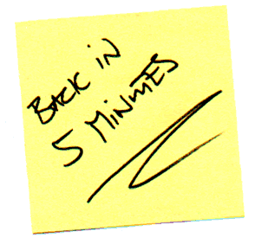
Break Time

Slide 28
Triple P In Practice: Orange County
Assessing Need
Starting Small
Peer Learning Community to provide support during early implementation
Adaptability – a program that could adapt in terms of intensity
Unique needs of our families – Primary Care, Stepping Stones, Teen
Filling a gap in available parenting supports
Small group of OC providers; 1 Child Welfare prevention SW at DSS
Gradual expansion to CPS

Slide 29
Triple P In Practice: Orange County
Learning as we go: How did we implement Triple P?
Incorporated into home visits
On-going parent feedback to assess – formal and informal
Addition of services based on need and parent feedback
Addressing barriers
Support from management at DSS

Slide 30
Triple P In Practice: Orange County
Overall Experience with Implementation:
Aligns well with best practices in Child Welfare and building Protective Factors
Focus on building good relationships and prevention strategies
Positive feedback from CPS SWs on implementation with families
Groups provide families with increased social supports, as well as increased reach of positive parenting information
Meeting needs of families, social workers, and seamless integration into other programming at DSS
Notes:
Pause for Q&A time.

Slide 31
Accessing Support
Your Local Implementing Agency
The DSS Implementation Support Specialist, Christina DiSalvo, christina.disalvo@unc.edu
Triple P America, Sara van Driel, sara@triplep.net

Slide 32
Resource Toolkit
Triple P 1-pager
Triple P Level Descriptions
Archived Triple P Brief Newsletters
TPOL Info
Is Triple P Right for Us?: An Agency Assessment
LIA map
Presentation Materials
Collaborative Listserv
Individual Agency Technical Assistance

Slide 33
What Questions Do You Have?
Let us know on the Jamboard!
https://jamboard.google.com/d/1yppLsp2uA6POZFwI4XrBkQMDW50hysy1yoTL_O1udxE/edit?usp=sharing

