Slide 1

Icebreaker Question
What song makes you feel the most nostalgic?
Notes:
What song makes you feel the most nostalgic?

Slide 2
NC CHILD WELFARE
TRIPLE P LEARNING COLLABORATIVE
Presenters:
Tamara Robertson, Impact Center at UNC’s FPG Institute
Kimberly Maloney, Impact Center at UNC’s FPG Institute
May 22, 2025

Slide 3
What to Expect Today
Connection Activity
Updates and Reminders
Ongoing Triple P Support
Questions, Resources, and Adjourn

Slide 4
Updates & Reminders
The Child Welfare newsletter, the Triple P Brief, will be published before the end of June 2025. Email Tamara Robertson if you want to be added to the listserv to receive the final publication.
Connect with your Lead Implementing Agency (LIA) for any needs or questions regarding Triple P delivery, such as training or coaching. If you are unsure of what region you are in, feel free to share in the comments and we will get your connected!
Updates from our NC DSS Partners will be shared live.

Slide 5

Spring Webinar Series
Please join us for our three-part Spring Webinar Series!
Please join us in this engaging 3-part webinar series that features organizational facilitators and barriers to effective implementation. A dedicated 50-minute discussion circle will follow after the third webinar for participants who want to talk more about how to apply ideas in their organizational settings.
Please share this invitation with any partners who may be interested in joining us!
Notes:
Whole-System Wellness: Trauma-Informed Care for Practitioners and Programs
Guest speaker: Kathy Lisborg, DSW, LCSW, University at Buffalo School of Social Work
Cultural Humility
Guest speaker: Mark Lapiz, MSW, and Program Manager III, Department of Program Support Research & Evaluation (PSRE) at the County of Santa Clara Social Services Agency
Discussion Circle and Breakouts
Facilitated by: The Impact Center at FPG

Slide 6

Ongoing Triple P Support
Notes:
After training and accreditation, Triple P practitioners who are partnered with Lead Implementing Agencies receive ongoing coaching services and support. These coaching services are grounded in supporting program fidelity.

Slide 7

Practitioner Support
Triple P Coaching
  LIA/regional
  SDA/agency
  Supervision
Training
Peer to Peer Support
PASS sessions
Practitioner Conferences
Notes:
LIA offers training opportunities at no cost depending on practitioner readiness and fit. Connect with LIA to learn more.

Slide 8

What’s Included in Coaching?
Proactive and Responsive Guidance and Support
Develop and Apply Strategies to Enhance Skills
Joint Planning, Observation, Reflection, and Feedback
Notes:
Coaching frequency varies – Should be confirmed with LIA coordinators

Slide 9
Quality Coaching Opportunities
Confident and Competent Practitioners are created through quality coaching. In return, practitioners:
  Increase the use of Triple P with families
  Deliver Triple P as intended
  Meet the needs of families within their communities
  Increase family satisfaction with Triple P services
  Positively impact short- and long-term outcomes

Slide 10
Triple P Training - Connect
Connect with LIAs
  Determine good fit: Identify Triple P levels that are most appropriate & needed in your delivery area
  Ensure Readiness: Potential practitioner plans to deliver Triple P once accredited
Connect with ICO4MCH Programs (Improving Community Outcomes for Maternal and Child Health) Implementing Triple P
  Available in Wake County, Mecklenburg County, Guilford County, and The Sandhills Collaborative (Cumberland County, Hoke County, Montgomery County, Richmond County, and Scotland County)
  Ages 0-5*

Slide 11
Triple P Training
Triple P Training
  Must attend 80% of training to become accredited to implement Triple P
  Pre-Accreditation Workshop
  Accreditation
Interested in learning about other levels?
  Audits for Triple P trainings are available at no cost
  Does not provide accreditation
Additional LIA trainings & expectations (i.e., data submission, fidelity, etc.)
Notes:
A Triple P Pre-Accreditation Workshop is offered to practitioners prior to accreditation, to provide an opportunity for individualized feedback on skill development and to practice and discuss any relevant implementation issues in the presence of a Triple P Trainer. Pre-Accreditation Workshops aim to reduce practitioners' anxiety and apprehension around the Triple P Accreditation process, reinforce all aspects of Triple P, and build their confidence to deliver the service.
A competency-based accreditation process must be completed, not only to officially recognize a practitioner's proficiency in program delivery, but also to ensure that Triple P will be delivered competently and successfully within the community.

Slide 12

Peer-to-Peer Support
Internal Support within Service Delivery Agencies (SDAs)
  Individual practitioners connect with LIA coordinators
Regional LIA Coaching System
  Newsletters
  Peer support meetings or learning sessions
  Practitioner Conference (if applicable)
PASS Sessions
Notes:
The role of the LIA isn’t necessarily to provide coaching to all practitioners within their community, but they’re there to ensure a coaching plan is built and carried out based on best practice. Some SDAs may be well-equipped to provide high-quality coaching internally – and it may not be called coaching. It may be called supervision, peer support, consultation, training and TA, PASS or mentoring.
Peer support is not required for coaching, and coaching is not required for peer support. However, coaching and peer support can occur together.

Slide 13

PASS Model
Peer Assisted Supervision and Support
  Incorporates evidence-based coaching best practices
  Used in a peer support format
Brings Triple P practitioners together to help them assess their strengths and refine their Triple P delivery
  PASS Session Checklist can be used as an observation tool during a coaching session
Click the image to play video clip 1 from Module 7: Community Coaching System

Slide 14


PASS Model
Click the image to play video clip 2 from Module 7: Community Coaching System
Click the image to play video clip 3 from Module 7: Community Coaching System

Slide 15

PASS Model
Click the image to play video clip 4 from Module 7: Community Coaching System
Notes:
PASS Model activities include case presentations, applying the self regulation framework, setting goals, and providing peer-to-peer professional development during sessions with peers that meets the needs of most practitioners.
Coaching isn’t needed to use the PASS model, and the PASS model isn’t needed to do coaching. PASS model can be done at the same time as coaching.
ICTP Module 7: Assessing Community Coaching Efforts - link above on the slide

Slide 16

Additional Triple P Support Resources
PCANC Training Calendar (if you are partnered with an LIA)
Triple P Practitioner Portal
Support from LIA (as needed)
ICTP Child Welfare Online Tools & Resources
  Archived Triple P Briefs
  Archived CWLC session recordings
Newsletters
  Regional LIA Newsletters
Notes:
PCANC Training Calendar - Varying topics to help practitioners with implementation of Triple P

Slide 17
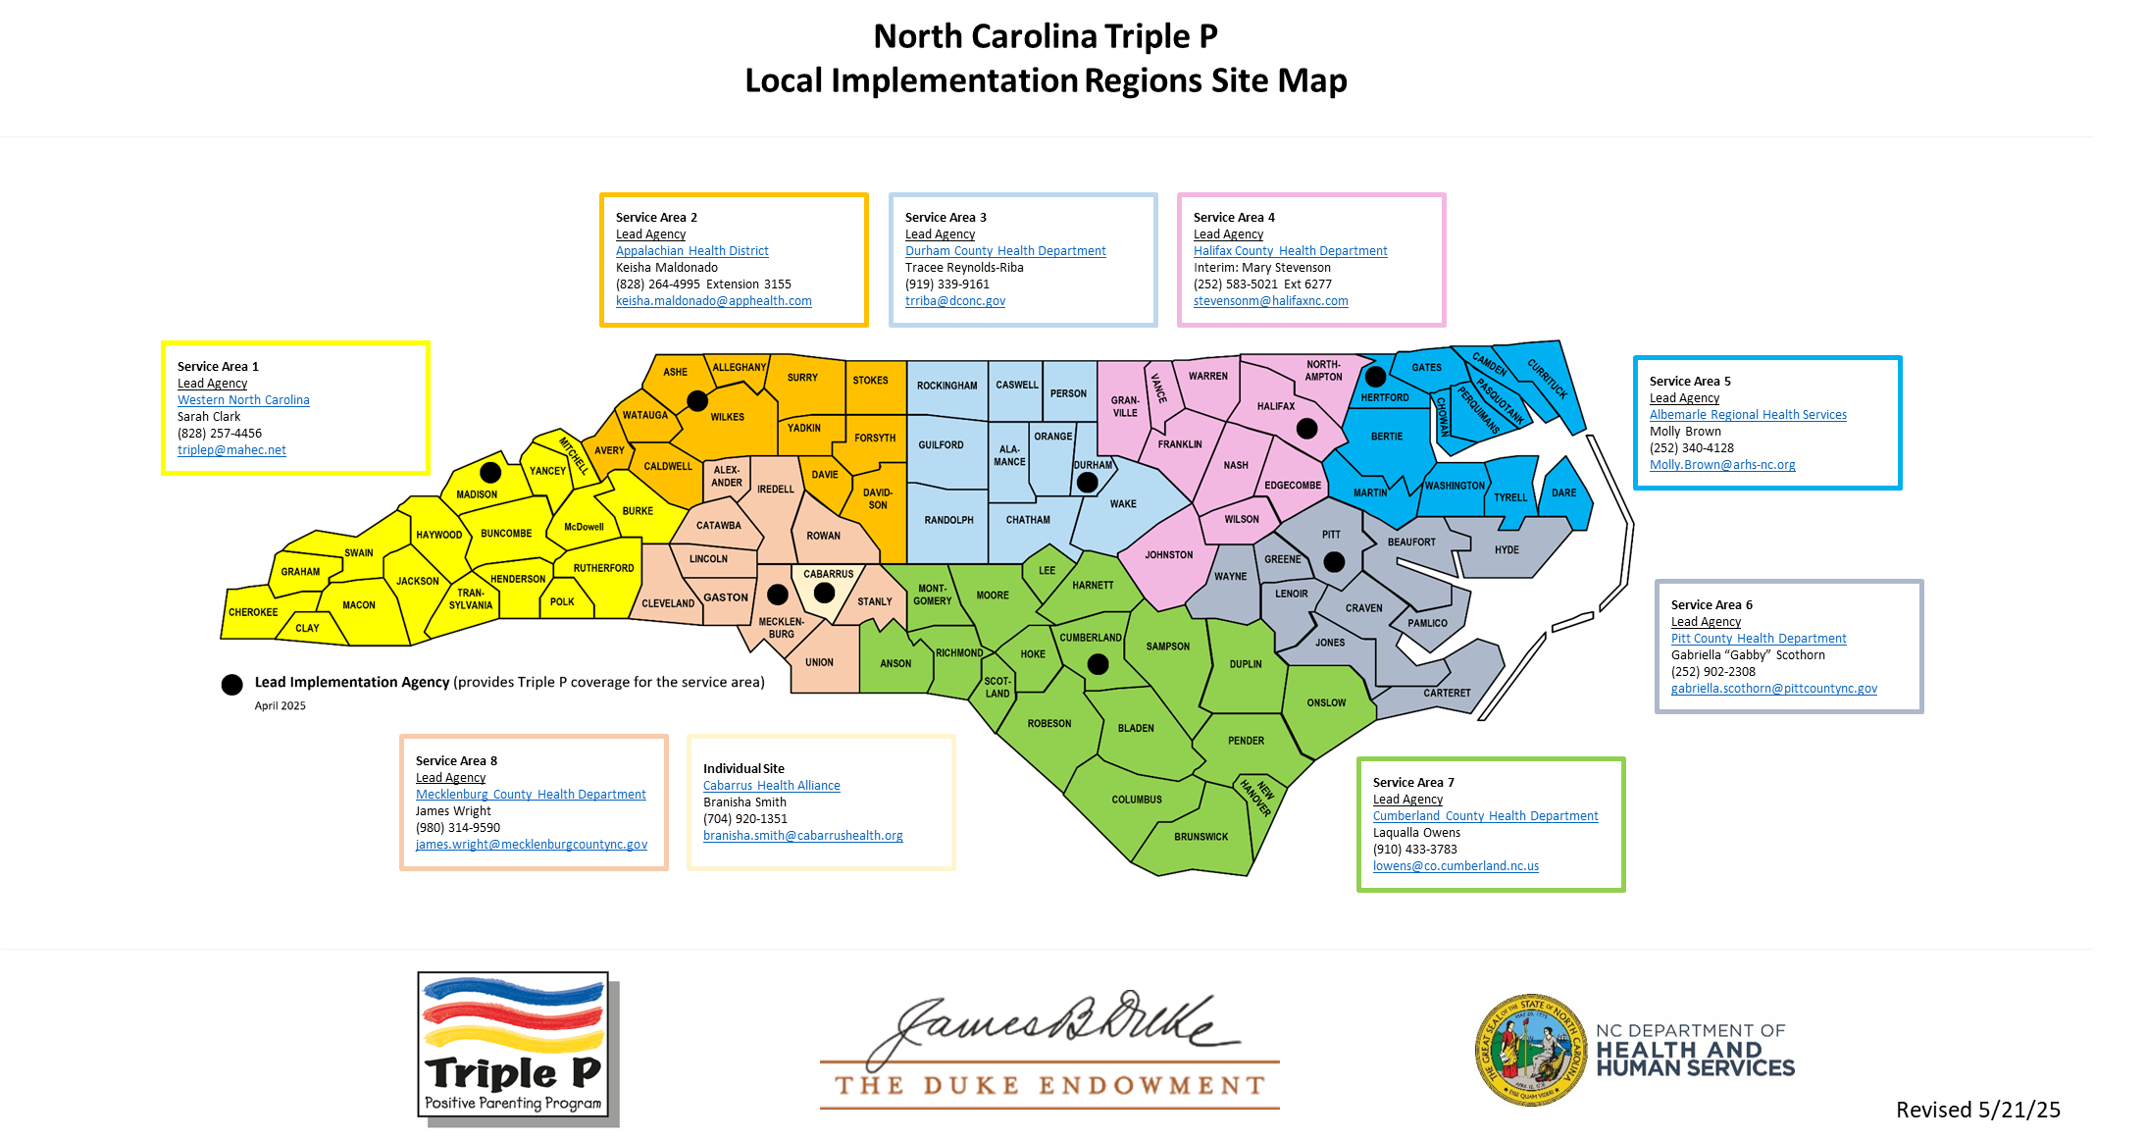
North Carolina Triple P Local Implementation Regions Site Map

Slide 18

Break Time

Slide 19

What Questions Do You Have?

Slide 20
Accessing Support
Remember to connect with your Lead Implementing Agency (LIA) for any needs or questions regarding Triple P delivery, such as training or coaching. If you are unsure of what region you are in, feel free to share in the comments and we will get your connected!
For any programming support needs, contact Triple P America - Sara van Driel, sara@triplep.net.

Slide 21
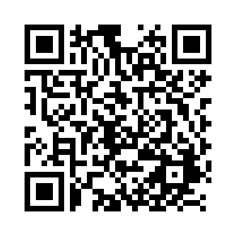
Thank you!
Reminder!
The ICTP Child Welfare Resources page has helpful information and tools including recordings and PPTs of all previous CWLCs.
*These tools and resources will continue to be available to you beyond June 2025.*
Up next!
Triple P Brief – June 2025
We need YOUR help! Please fill out this 6-question survey to help us plan for future learning collaborative sessions! Scan the QR code with your phone or click the link on the QR code.

