Slide 1
North Carolina’s Triple P Implementation Network
Sandy Diehl & Maggie Sullivan
April 4, 2023

Slide 2
Today’s Goals
To show sample data from our most recent SNA
To discuss ways to apply what we’re learning for implementation support

Slide 3
Our Study Aims
1
Identify and map the Triple P social network
2
Measure baseline attitudes, knowledge and behaviors around Triple P implementation and support
3
Describe network communication preferences
4
Compare outcomes across two timepoints
5
Brainstorm ways to use this data in a meaningful way

Slide 4
The Triple P Network

Slide 5
Data Collection/Recruitment
Participant recruitment included
emails to Triple P network database
and presentation at a NCLC meeting
Response rate: 41%
n = 164
Notes:
67 completed

Slide 6
Measures
Demographic Questions
Who do you go to for information, advice or support?
20 questions about perceptions of network support
Social Media use/preferences
Notes:
Scale of Perceived Network Support (SPNS): A 20-item scale measuring network support of implementation efforts. Each item is rated on a Likert scale from 1-5.

Slide 7
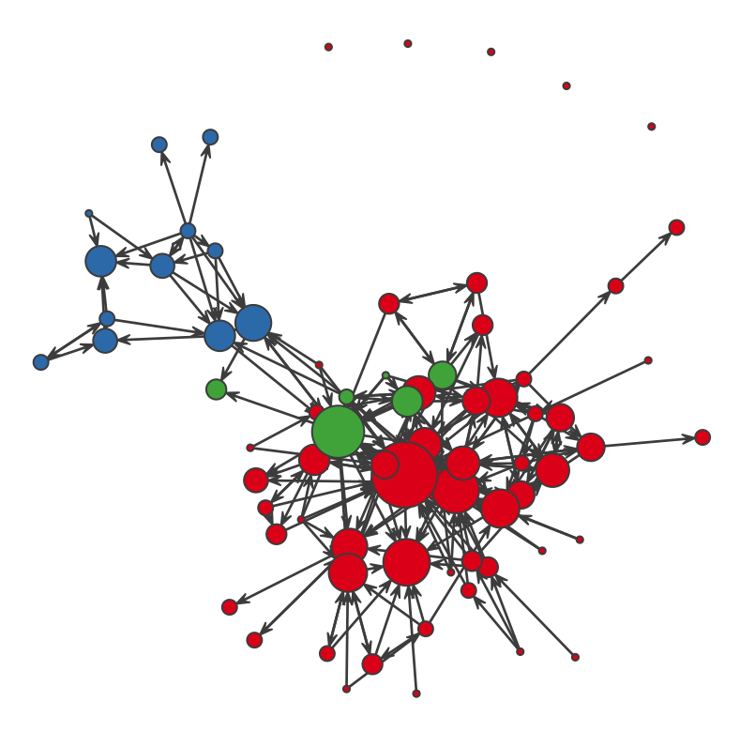
region
”Who do you go to for information, support, or guidance on Triple P implementation?”
NC
SC
Both

Slide 8
Stakeholder
Role
1
Community TP collaborative agency partner
2
TP service delivery agency leadership
3
5
# of participants
7
State funder, state administrator, state program office/staff
18
Support system/intermediary support/TA/program purveyor
19
Lead implementing agency/backbone organization leadership
19
TP coordinator/implementation team member

Slide 9
LIA response
LIA | # of Survey Respondents
Western North Carolina | 0
Appalachian Health District | 4
Durham County Health Department | 2
Halifax County Health Department | 2
Albemarle Regional Health Services | 3
Pitt County Health Department | 4
Cumberland County Health Department | 3
Mecklenburg County Health Department | 3
Cabarrus Health Alliance | 1
Wake | 2

Slide 10
2020
2022
Christina DiSalvo
Will Aldridge
Will Aldridge
Cathy Henderson
Sherra Lawrence
0-1 Year
2-3 Years
4-6 years
7+ Years
Unknown

Slide 11
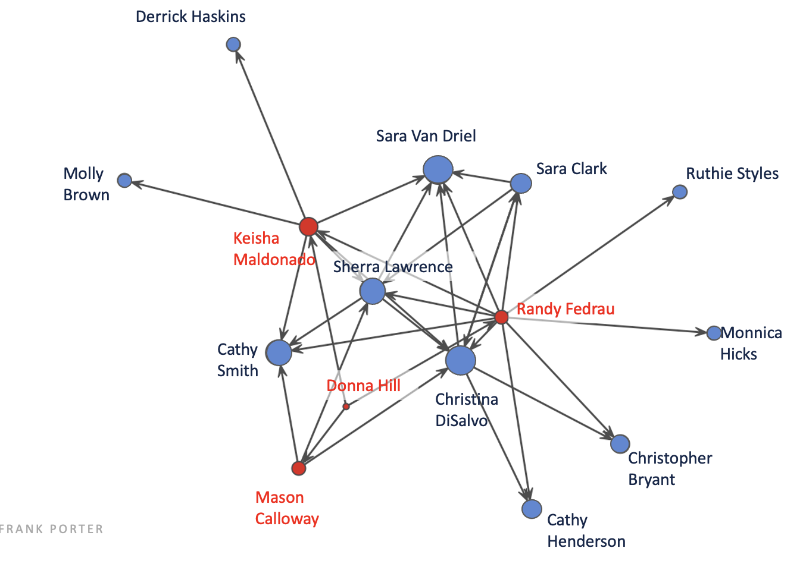

Slide 12
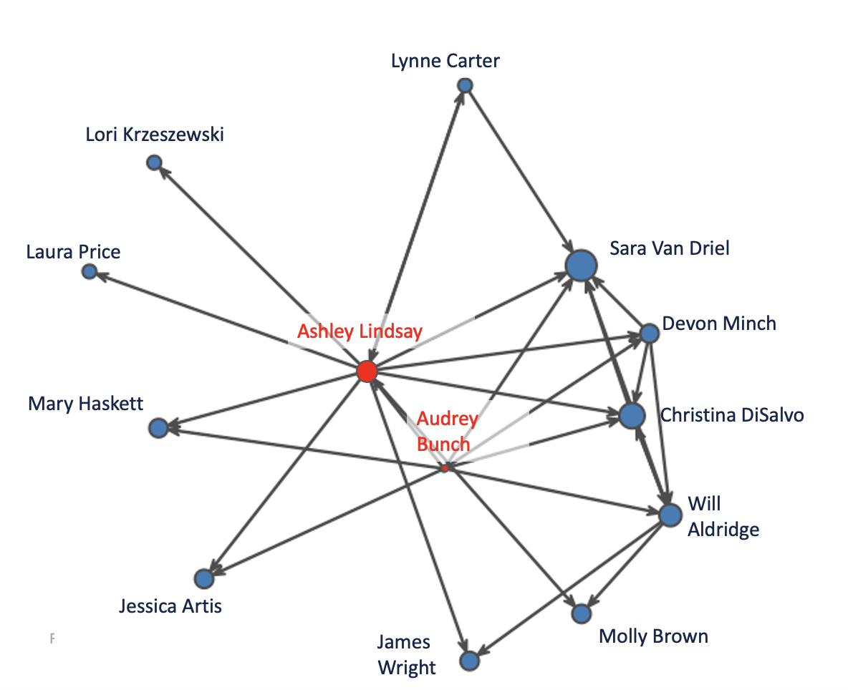

Slide 13
What can we answer?
Size and composition of network – demographics, density, reciprocity, centrality
How the network changes over time
Central figures
Bridgers
Size, demographics, ‘newness’
Local implementation interactions within and across LIAs, Support System, and Partners

Slide 14
Key Takeaways.
Need more complete data – response rate
Review participant list to make sure we’re defining and reaching our network (add new nominees)
Is there anything else that you would want to learn about your Triple P network?

Slide 15
Jamboard Brainstorming
What would communication patterns within the full Triple P network ideally look like?
Information, advice, support, or guidance
Who should participate?
How might you use these regional maps?
Would it be helpful to see broader local parent support networks and who connects with whom?
Are there other questions you’d like to ask?
What would be helpful in supporting full and regional network connections?

Slide 16
Questions?

